Slide 1
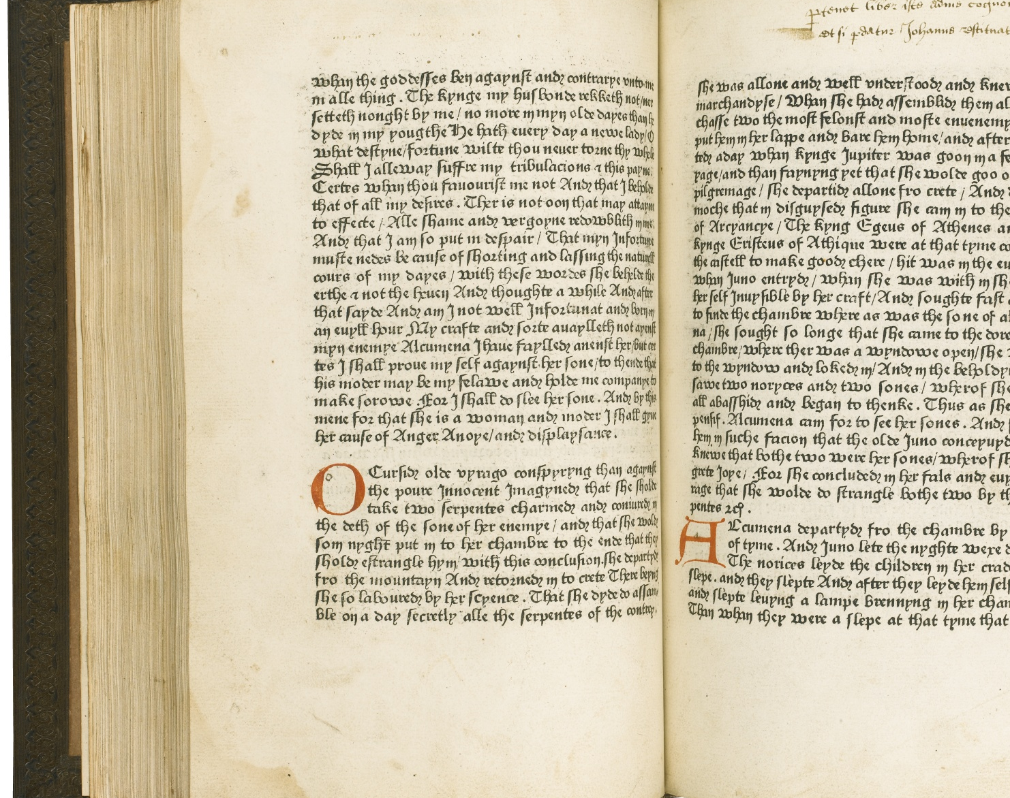
Understanding the Limitations of Using Large Language Models for Text Generation
Daphne Ippolito
Advisors: Chris Callison-Burch, Douglas Eck
Thesis committee: Marianna Apidianaki, David Grangier (external), Dan Roth, Lyle Ungar (chair)
Notes:
Recuyell of the Historyes of Troye (1464)
Call out during presentation that I was both a PhD student and at Google.
This allowed interested experiments beyond the scope of what is usual in a thesis.

Slide 2
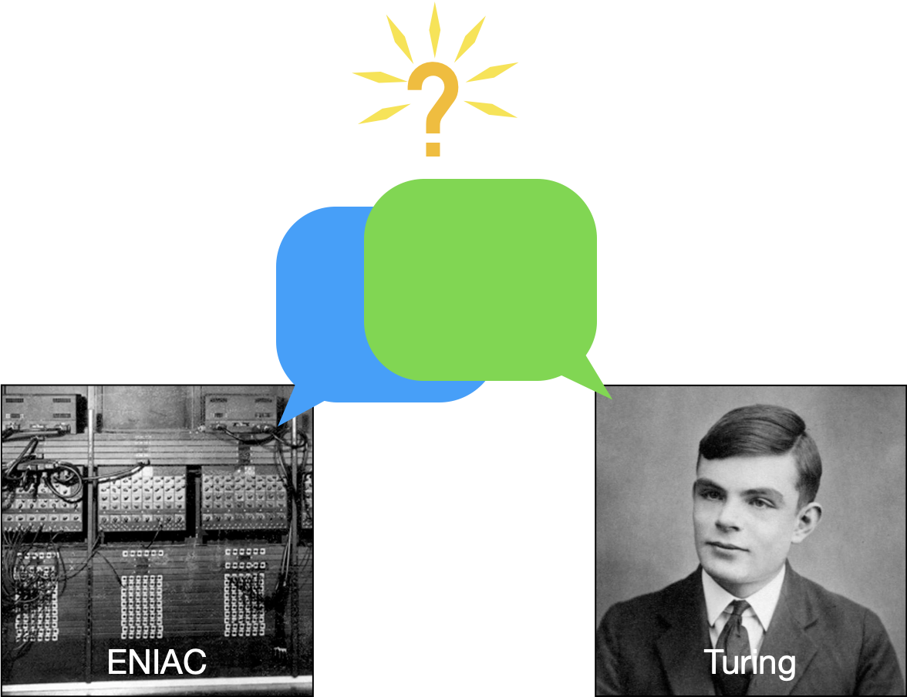
The Imitation Game
I believe that in about fifty years’ time it will be possible to programme computers … to make them play the imitation game so well that an average interrogator will not have more than 70 per cent, chance of making the right identification after five minutes of questioning.
-Turing, 1950
Notes:
We are still far from reaching this goal but it is true that…

Slide 3
Thesis: Understanding the Limitations of Using Large Language Models for Text Generation
Text generation encompasses tasks that involve generating word sequences in a natural language, like English.
Most often we care about conditioned text generation: given some input and a goal, generate a word sequence that achieves the goal.
NLG = natural language generation

Slide 4
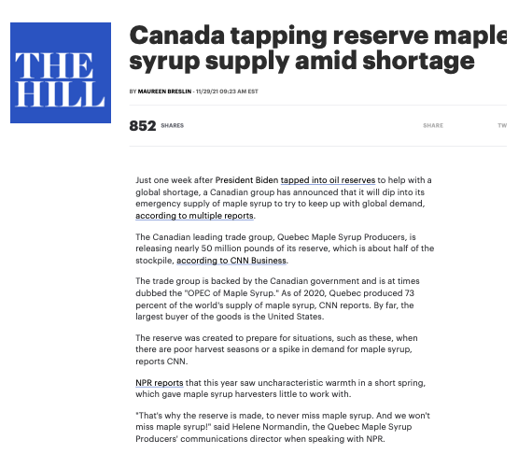
Text Summarization
Generated Summary:
The Canadian leading trade group, Quebec Maple Syrup Producers, is releasing nearly 50 million pounds of its reserve. The reserve was created to prepare for situations, such as poor harvest seasons or a spike in demand for maple syrup. This year saw uncharacteristic warmth in a short spring, which gave maple syrup harvesters little to work with.
Jingqing Zhang, et al. "Pegasus: Pre-training with extracted gap-sentences for abstractive summarization." In PMLR, 2020.
Notes:
This summary is as good as one I could write myself.
Just one week after President Biden tapped into oil reserves to help with a global shortage, a Canadian group has announced that it will dip into its emergency supply of maple syrup to try to keep up with global demand, according to multiple reports.
The Canadian leading trade group, Quebec Maple Syrup Producers, is releasing nearly 50 million pounds of its reserve, which is about half of the stockpile, according to CNN Business.
The trade group is backed by the Canadian government and is at times dubbed the "OPEC of Maple Syrup." As of 2020, Quebec produced 73 percent of the world's supply of maple syrup, CNN reports. By far, the largest buyer of the goods is the United States.
https://thehill.com/business-a-lobbying/business-a-lobbying/583335-canada-tapping-reserve-maple-syrup-supply-amid

Slide 5
Text Summarization
Generated Summary:
The Canadian leading trade group, Quebec Maple Syrup Producers, is releasing nearly 50 million pounds of its reserve. The reserve was created to prepare for situations, such as poor harvest seasons or a spike in demand for maple syrup. This year saw uncharacteristic warmth in a short spring, which gave maple syrup harvesters little to work with.
✅ Fluent
✅ Accurate
Jingqing Zhang, et al. "Pegasus: Pre-training with extracted gap-sentences for abstractive summarization." In PMLR, 2020.
Notes:
Most importantly it is both fluent and accurate
Just one week after President Biden tapped into oil reserves to help with a global shortage, a Canadian group has announced that it will dip into its emergency supply of maple syrup to try to keep up with global demand, according to multiple reports.
The Canadian leading trade group, Quebec Maple Syrup Producers, is releasing nearly 50 million pounds of its reserve, which is about half of the stockpile, according to CNN Business.
The trade group is backed by the Canadian government and is at times dubbed the "OPEC of Maple Syrup." As of 2020, Quebec produced 73 percent of the world's supply of maple syrup, CNN reports. By far, the largest buyer of the goods is the United States.
https://thehill.com/business-a-lobbying/business-a-lobbying/583335-canada-tapping-reserve-maple-syrup-supply-amid

Slide 6
Style Transfer
Input sentence:
I had a protruding snout, rows of teeth visible in my smile.
Rewrite the input sentence to...
be more comical:
My snout was covered in warts and my teeth were crooked, but I still thought I was the most adorable dog at the doggie party!
be more descriptive:
I looked like an alligator when I smiled.. My gums were red and inflamed and my rows of teeth stuck out, making me look even more like a beast.
include a metaphor:
My smile could be compared to a shark's open mouth, rows of teeth protruding from my gums as I grinned at the people in the market.
Emily Reif*, Daphne Ippolito*, Ann Yuan, Andy Coenen, Chris Callison-Burch, and Jason Wei. "A recipe for arbitrary text style transfer with large language models." In ACL 2022. See https://bit.ly/3fLDuci for more examples.
Notes:
https://thehill.com/business-a-lobbying/business-a-lobbying/583335-canada-tapping-reserve-maple-syrup-supply-amid

Slide 7
Style Transfer
Input sentence:
I had a protruding snout, rows of teeth visible in my smile.
Rewrite the input sentence to...
In the past: limited to specific style transfers we had training data for
Today: perform any arbitrary style transfer
be more comical:
My snout was covered in warts and my teeth were crooked, but I still thought I was the most adorable dog at the doggie party!
be more descriptive:
I looked like an alligator when I smiled.. My gums were red and inflamed and my rows of teeth stuck out, making me look even more like a beast.
include a metaphor:
My smile could be compared to a shark's open mouth, rows of teeth protruding from my gums as I grinned at the people in the market.
Emily Reif*, Daphne Ippolito*, Ann Yuan, Andy Coenen, Chris Callison-Burch, and Jason Wei. "A recipe for arbitrary text style transfer with large language models." In ACL 2022. See https://bit.ly/3fLDuci for more generations.
Notes:
https://thehill.com/business-a-lobbying/business-a-lobbying/583335-canada-tapping-reserve-maple-syrup-supply-amid

Slide 8
Thesis: Understanding the Limitations of Using Large Language Models for Text Generation
Modern language models are neural networks which have been “trained” on millions of examples of human writing.
This allows them to predict text sequences that sound human-like.
Neural networks contain “learned” parameters which get updated during training.
Models with more parameters are generally better than ones with fewer.
Notes:
Better here means better at representing all of those examples of human writing they were trained on, and thus better at generating high-quality text.

Slide 9
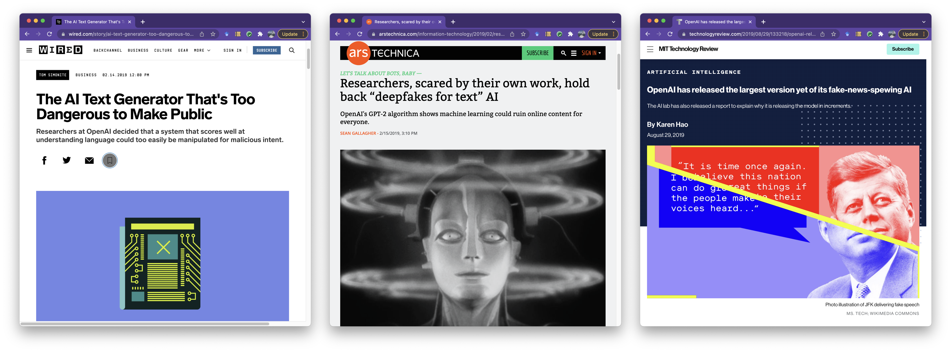
Thesis: Understanding the Limitations of Using Large Language Models for Text Generation
In 2019, the company OpenAI announced GPT-2 (General Purpose Transformer 2),
a 1.5B parameter neural language model “too dangerous” to release.
Notes:
On the previous slides I mentioned that text generation is much better than it used to be. This is thanks to new types of neural language models.
2018: Transformer architecture, which allowed us to train neural networks more efficiently on more data, than previous types of neural networks.
2019: OpenAI announched GENERAL PURPOSE TRANSFORMER 2
1.5 billion params was BIG
Popular press picked up on this as the model “too dangerous to release”
While I didn’t doubt the GPT-2 models had all sorts of real ethical problems, I was skeptical of the claims that the text was so good it was dangerous.
I decided I wanted to measure just how good these models really were at producing text that is indistinguishable from real human-written text.
GPT-2 was only 1.5B parameters
Neural language models are the technology that enables both of the applications I just mentioned.
In 2018, Google came out with a neural architecture called the Transformer, which made these models much, much better at understanding language.
And in early 2019, the company OpenAI announced they had trained a Transformer neural network on text from the internet. Their model has 1.5 billion model parameters, which seemed like an incredible amount at the time.
OpenAI decided originally that they were not going to release their General Purpose Transformer, acronymed GPT-2, until further research could be conducted into the safety if its generations.
The generations from Open’s GPT-2 model were sufficiently impressive that the popular news media quickly picked up on this as being a text generator that was too dangerous to release, so dangerous even its own creators were scared of it.
At the time, I was just getting into doing research on story generation.
I had been training my own, albeit smaller models for story writing, and I had been very frustrated with the quality of the generations.
While I didn’t doubt the GPT-2 models had all sorts of real ethical concerns, I was skeptical of the claims that the text was
I decided to try to answer the research questions:
Are humans actually fooled by machine-generated text?
Is it possible to design automatic detection systems which can aid humans in identifying when they’re being misled?
And finally, what errors do humans or automatic detection systems pick up on to come to their conclusions?

Slide 10
Models Continue to Get Bigger
Notes:
Fast forward to 2022, and OpenAI’s latest model, GPT-3, is 175B parameters. No longer deemed too dangerous to release, GPT-3 has a public API and is increasingly being incorporated into real-world applications.
You’ll even hear people referring to the old GPT-2 as small.
It is also worth noting that the biggest models tend to be inaccessible.
PaLM 540B parameters.

Slide 11
What are the implications?
Potential for positive impact
Advancing research
NLP, robotics, and even the humanities and social sciences.
Entertainment
Interactive fiction, video games, creative writing
Human-AI collaboration for accomplishing tasks
Potential for harm
Training data problems
Biased or incomplete data
Copyright and privacy issues
Negative societal impact
Proliferation of fake news, social media posts, and reviews
Deep fakes that fool humans
Expensive to train
Both in terms of dollars and energy usage
Notes:
NEGATIVE
Training datasets have gotten so big, we don’t really know what’s in them.
Models trained on biased data could perpetuate biases.
Train sets also include things like data that is still under copyright or people’s private information.
Generated text can have negative societal impact.
Fake news and social media posts could influence elections
fake product reviews could change consumer behaviour.
Models are getting increasingly expensive to train and use, both in terms of dollars and energy usage
This leads to the question of who gets to control large language models?
Right now, most of the biggest models have come out of huge industry research labs.

Slide 12
What are the implications?
Potential for positive impact
Advancing research
NLP, robotics, and even the humanities and social sciences.
Entertainment
Interactive fiction, video games, creative writing
Human-AI collaboration for accomplishing tasks
Potential for harm
Training data problems
Biased or incomplete data
Copyright and privacy issues
Negative societal impact
Proliferation of fake news, social media posts, and reviews
Deep fakes that fool humans
Expensive to train
Both in terms of dollars and energy usage

Slide 13
Thesis Statement
We must build a deeper understanding of neural network-powered language generation systems before they are safe to deploy widely.
This involves understanding the ways machine-generated text differs from the text a human would write given the same writing task.
Humans and NLG systems make different word choices.
NLG systems may plagiarize verbatim from their training data when asked to produce novel content.
Differences in how humans and NLG systems write make evaluation tricky.
NLG systems should be evaluated holistically as part of larger tools meant to assist human writers in tasks they wish to do.
Notes:
Generated text that is pleasing to human readers tends to have significantly more common words in it than text a real human would write.
If you revise your generation method to reduce this bias, human readers don’t like the generated text as much.
In the second case, when language models memorize their training data, this can lead to us over-representing the strength of NLG systems by attributing generalization ability to what is actually just memorization ability,=.

Slide 14
Here is what I did in thesis proposal.

Slide 15
Thesis Outline
Detecting Machine-Generated Text
Measuring and Mitigating the Risk of Memorization
Enabling Applications in Creative Writing

Slide 16
Thesis Outline
Enabling Applications in Creative Writing
Measuring and Mitigating the Risk of Memorization
Detecting Machine-Generated Text

Slide 17
Talk Outline
Detecting Machine-Generated Text
Measuring and Mitigating the Risk of Memorization
Enabling Applications in Creative Writing

Slide 18
Enabling Applications in Creative Writing
Ann Yuan, Andy Coenen, Emily Reif, Daphne Ippolito. “Wordcraft: Story Writing with Large Language Models.” In IUI 2022.
Daphne Ippolito, et al. “A Recipe for Arbitrary Text Style Transfer with Large Language Models.” In ACL 2022.
Daphne Ippolito, et al. ”The Case for a Single Model that can Both Generation Continuations and Fill in the Blank." In submission 2022.
Daphne Ippolito, et al. “Unsupervised Hierarchical Story Infilling” In ACL Workshop on Narrative Understanding 2019.
Detecting Machine-Generated Text
Daphne Ippolito, et al. "Investigating Human Ability to Detect Boundaries Between Human-Written and Machine-Generated Text." In submission 2022.
Hugh Zhang, Daniel Duckworth, Daphne Ippolito, et. al., "Trading Off Diversity and Quality in Natural Language Generation." In EACL HumEval Workshop 2021.
Daphne Ippolito, et al. "RoFT: A Tool for Evaluating Human Detection of Machine-Generated Text." In EMNLP System Demonstrations 2020.
Daphne Ippolito, et al. "Automatic Detection of Generated Text is Easiest when Humans are Fooled." In ACL 2020.
Daphne Ippolito, et. al. "Comparison of Diverse Decoding Methods from Conditional Language Models." In ACL 2019.
Measuring and Mitigating the Risk of Memorization
Daphne Ippolito, et. al. “Deduplicating Training Data Makes Language Models Better.” In ACL 2022.
Chiyuan Zhang, Daphne Ippolito, et al. “Counterfactual Memorization in Neural Language Models.” In submission 2022.
Nicholas Carlini, Daphne Ippolito, et. al. “Quantifying Memorization across Neural Language Models.” In submission 2022.
Notes:
Finally, in early 2020, I did some some non-NLP related research into the privacy considerations around digital contact tracing. I won’t be talking about this line of work in my talk, but I’m happy to chat about later today.

Slide 19
Enabling Applications in Creative Writing Detecting Machine-Generated Text Measuring and Mitigating Memorization Thesis Takeaways
Notes:
Possibly add a pivot slide recapping what we’ve covered so far, and then transitioning to the positive.

Slide 20
TODOs
Talk thus far has been slightly negative, focusing on some of the gotchas of using LMs for generation.
However, I also see the potential for language generation models to be useful and transformative.
Critically, they ought to be employed to assist rather than replace humans.
Notes:
Talk thus far has been slightly negative, focusing on some of the gotchas of using LMs for generation.
However, I also see the potential for language generation models to be useful and transformative.
Critically, they ought to be employed to assist rather than replace humans.

Slide 21
Why work on creativity?
Stories are a challenging domain.
Narrative arcs, dialog, character tracking, world knowledge.
However, mistakes that are a liability in fact-based tasks can be an asset in creative ones.
Creative writers are a great target audience.
Notes:
Stories are a challenging domain
I would argue stories are harder than generating just fact-based Wikipedia-style content.
Mistakes are a liability in fact-based tasks but can be an asset in creative ones.
Getting a fact about the world wrong is a real problem in summarization or text simplification. But making up facts about the world could be a great way to give writers ideas.
Creative writers are a great target audience.
For the longest time, robots and computers that could speak like and with humans, were the domain of science fiction writers, so it felt to me like science fiction writers are the people I ought to go to ask to assess the progress that’s been made.

Slide 22
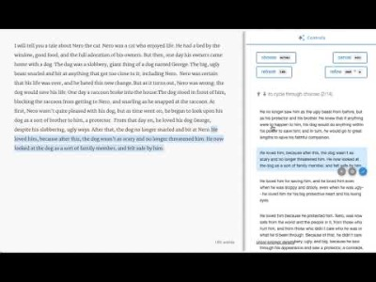
Notes:
https://www.youtube.com/watch?v=HthbABWE-xw&t=888081s

Slide 23
Wordcraft Text Editor
Continuation
Ann Yuan, Andy Coenen, Emily Reif, and Daphne Ippolito. Wordcraft: Story Writing with Large Language Models. IUI 2022.

Slide 24
Wordcraft Text Editor
Continuation
Infilling
Ann Yuan, Andy Coenen, Emily Reif, and Daphne Ippolito. Wordcraft: Story Writing with Large Language Models. IUI 2022.

Slide 25
Wordcraft Text Editor
Continuation
Infilling
Custom tasks and style transfer
Ann Yuan, Andy Coenen, Emily Reif, and Daphne Ippolito. Wordcraft: Story Writing with Large Language Models. IUI 2022.
Notes:
TODO: Add easier-to-parse table with some transformations in it.

Slide 26
Wordcraft Text Editor
Continuation
Infilling
Custom tasks and style transfer
Writing suggestions
Ann Yuan, Andy Coenen, Emily Reif, and Daphne Ippolito. Wordcraft: Story Writing with Large Language Models. IUI 2022.

Slide 27
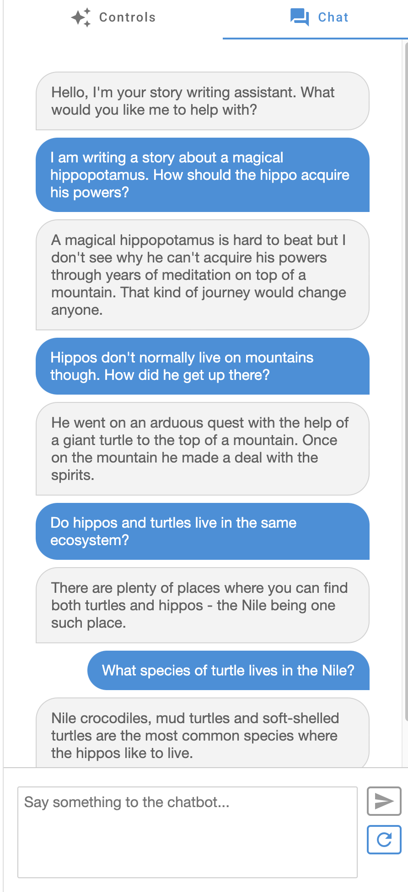
Chatbot interface
Ann Yuan, Andy Coenen, Emily Reif, and Daphne Ippolito. Wordcraft: Story Writing with Large Language Models. IUI 2022.

Slide 28
Controls in Wordcraft
Story seeds: When the editor is empty, the system proposes story ideas according to a user-specified prompt
Continuation: The system proposes a continuation to the text to the left of the user's cursor.
Elaborate selection: The text the user has selected is expanded upon.
Generate text from a custom prompt: The user can type in a prompt, for example “tell me what the cat does next” and get suggestions.
Fill in the blank: The user sees alternatives for the text they have selected.
Rewrite selection: The user can ask Wordcraft to rewrite their selected text according to some property. For example, "to be Shakepearean" or "to include a metaphor.”

Slide 29
Controls in Wordcraft
Story seeds: When the editor is empty, the system proposes story ideas according to a user-specified prompt
Continuation: The system proposes a continuation to the text to the left of the user's cursor.
Elaborate selection: The text the user has selected is expanded upon.
Generate text from a custom prompt: The user can type in a prompt, for example “tell me what the cat does next” and get suggestions.
Fill in the blank: The user sees alternatives for the text they have selected.
Rewrite selection: The user can ask Wordcraft to rewrite their selected text according to some property. For example, "to be Shakepearean" or "to include a metaphor.”
All controls use LaMDA as the underlying language model.

Slide 30
Wordcraft User Study: Novice Writers
Participants: 25 novice writers recruited from a mailing list for creative writing
Goal: Understand whether users preferred the full Wordcraft controls to:
A text editor that just suggests continuations
A text editor alongside a conversational chatbot
Task: Writers spend 10 minutes writing a story in each experimental setting, following a provided prompt.
Takeaways:
Participants found the full Wordcraft setting to be more helpful than the two baseline settings.
Participants appreciated the chatbot interface even though it couldn’t “read” their stories.
Study Limitations:
Controlled experimental setting
All participants were Google employees
Notes:
You arrive at Grandma's funeral to find thousands of people from around the world also in mourning. You are entirely unaware that Grandma had 16.4m followers on Twitter.
All of the `No. 1 Dad' mugs in the world change to show the actual ranking of Dads suddenly.
You lost your sight - along with everyone else on Earth - in The Great Blinding. Two years later, without warning, your sight returns. As you look around, you realize that every available wall, floor and surface has been painted with the same message - Don't Tell Them You Can See.

Slide 31
Controls in ⭐Updated⭐ Wordcraft
Story seeds: When the editor is empty, the system proposes story ideas according to a user-specified prompt
Continuation: The system proposes a continuation to the text to the left of the user's cursor.
Elaborate selection: The text the user has selected is expanded upon.
Generate text from a custom prompt: The user can type in a prompt, for example “tell me what the cat does next” and get suggestions.
Fill in the blank: The user sees alternatives for the text they have selected.
Rewrite selection: The user can ask Wordcraft to rewrite their selected text according to some property. For example, "to be Shakepearean" or "to include a metaphor.”
Chatbot interface: The user can converse with a chatbot about their story.
Notes:
We updated Wordcraft to include a chatbot interface in addition to the controls from the first version.
We also modified the chatbot to include the text editor contents as part of its conversational history, so that users could reference their story in conversation.

Slide 32
Wordcraft User Study: Experienced Writers
Participants: 13 published authors, including poets, novelists, script writers.
Goal: Understand the potential and limitations of NLG technology for writers with established styles and workflows.
Tasks: Write a ~1,500 word story for a digital literary magazine. …… ….Keep a journal of their experience.
Notes:
Goal: To better understand how NLG technology could be useful for people who already have their own established writing styles and workflows.
Instead of an artificial setting, we properly commissioned the writers to writer 1,500 word stories for a digital literary magazine, using Wordcraft in their writing process.
We also asked them to keep journals of their experience.

Slide 33
How did writers successfully use Wordcraft?
Idea Generator
Brainstorming Partner
Generation of specific details
Exploration of Rewriting

Slide 34
How did writers successfully use Wordcraft?
Idea Generator
"a place on my computer to go that looked like a blank page but did not behave as such"
Brainstorming Partner
“The chat is an amazing tool for brainstorming or rubber-ducking. Its conversational quality is perfect to talk about plot, characters and wordbuilding.”
Research assistant
"It’s kind of great to use the chat interface and treat LaMDA as a thesaurus, quote finder, and general research assistant.”
Asking Wordcraft: “how would a robot argue this point?”
Generation of specific details
"I asked Wordcraft to come up with some names for some “Maggot Warriors” and then turn these names into bios and descriptions."
Explorations of Rewriting
Rewriting the same passage many different ways.

Slide 35
How did the system fail?
Struggled to capture distinct styles and voices
Only one consistent writing style: “novice fan-fiction writer”
Could not handle stories with multiple distinct voices
Preferred to "tell" rather than "show”
Suggestions were cliché and uninteresting
Potential for accidental plagiarism
Suggestions got worse as the story got longer
Notes:
Only one consistent writing style: Writers were frustrated that it did not mimic their writing styles
Could not handle stories with multiple distinct voices: for example, one writer attempted a story that contained emails between a startup founder and his shareholders. It failed to capture this.
Suggestions were cliché and uninteresting: Writers tend to write for very particular audiences. The language model seemed to have a fixed built-in audience of general internet users, and it was very hard to move past the most common tropes for whatever genre cues it picked up on,
Preferred to "tell" rather than "show”: this meant that the system rarely generated text that could be copied directly into writers’ stories. It still needed more working.
Potential for accidental plagiarism: Several participants were concerned they had no way to know whether the model’s suggestions were truly original. Their fear was justified when the model generated IP from Spiderman or Harry Potter.

Slide 36
How did the chatbot fail?
It overpromised beyond its capabilities
“I'll email you a draft with my suggestions.”
It couldn’t meaningfully answer questions about the story
"Which parts of the story need more details?"
"Does this feel like a fast-paced action story?"

Slide 37
Enabling Applications in Creative Writing Detecting Machine-Generated Text Measuring and Mitigating Memorization Thesis Takeaways

Slide 38
The Detection Task
Given a passage of text, decide whether it was written by a human or generated by a natural language generation system.
How good are humans at this task?
How good are automatic discriminators?
Daphne Ippolito*, Daniel Duckworth*, Chris Callison-Burch, and Douglas Eck. "Automatic Detection of Generated Text is Easiest when Humans are Fooled." In ACL 2020.
Notes:
I am going to convince you that when the outputs from large language models are very hard for humans to detect, they are easiest for automatic classifier to detect.
There are two ways of detecting machine-generated text: • Humans can read it and make a prediction
• We can train a classifier to try to automatically detect it

Slide 39
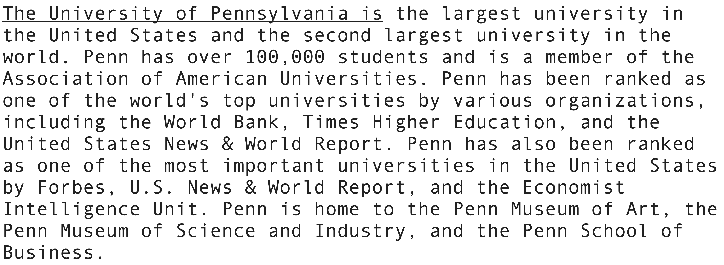
Is this text machine-generated?

Slide 40
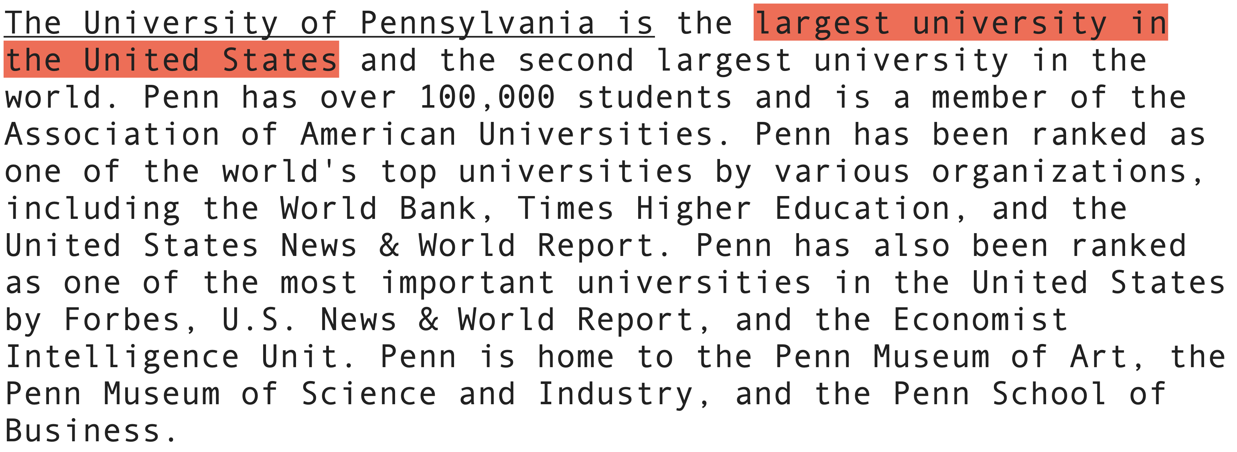
Is this text machine-generated? Answer: yes

Slide 41
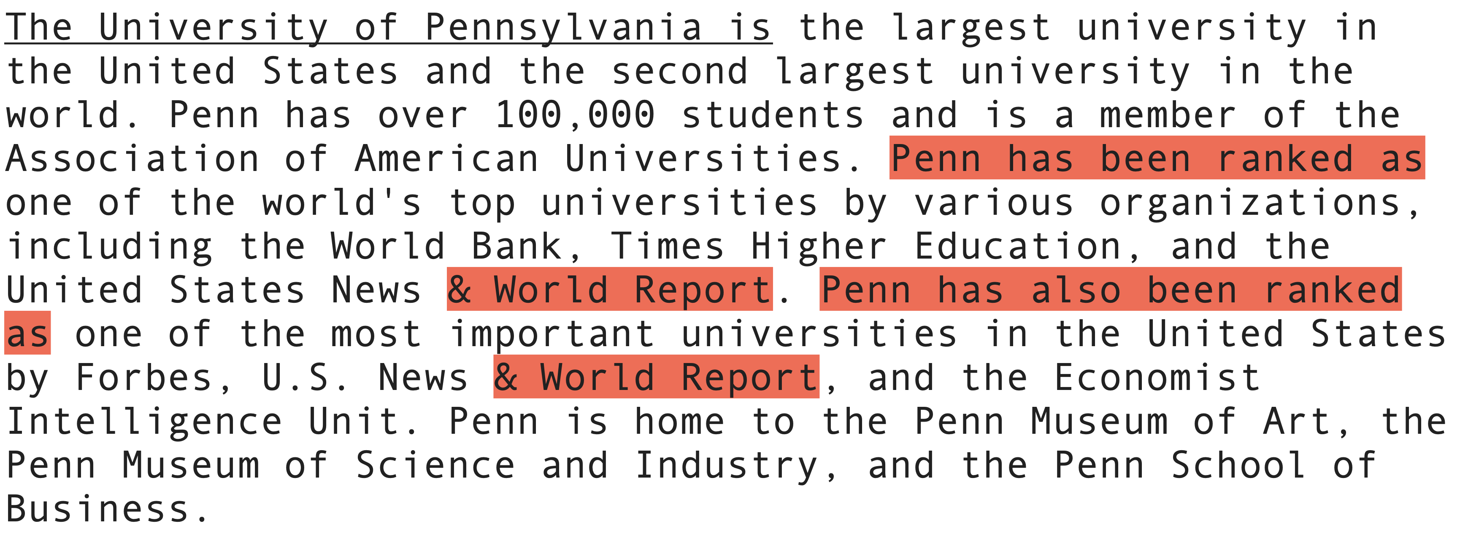
Is this text machine-generated? Answer: yes
Notes:
Penn likes talking about its ranking, but this repetitiveness is excessive even by Penn’s standards.

Slide 42
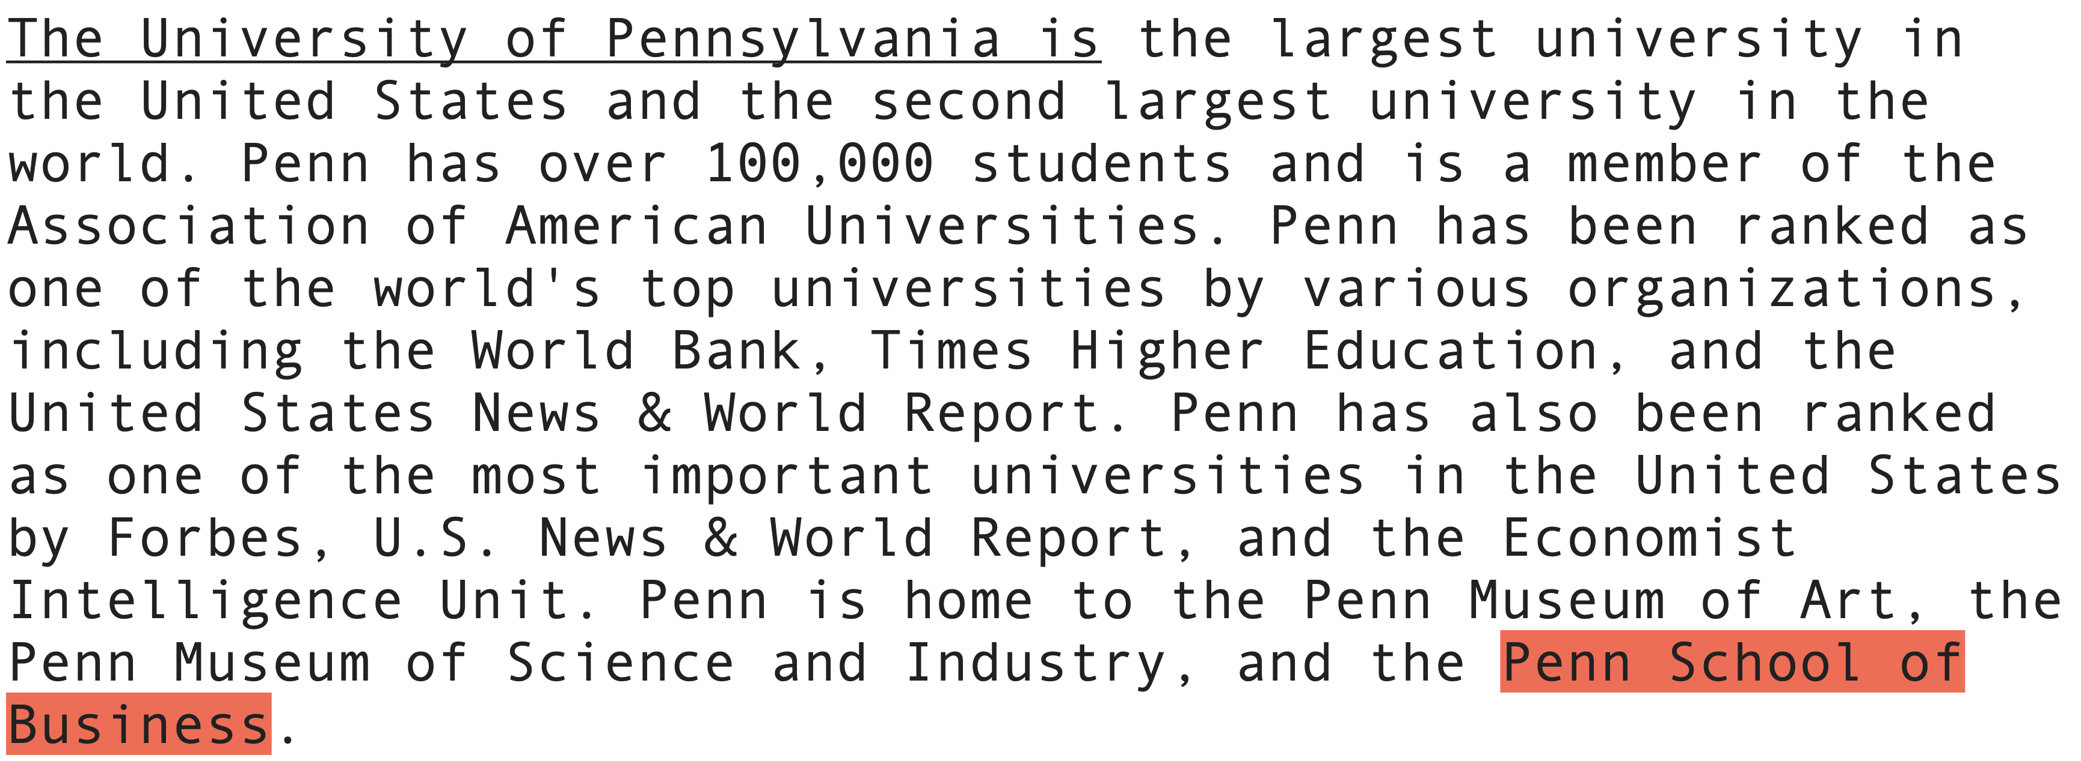
Is this text machine-generated? Answer: yes
Notes:
Anyone from Penn knows that one of the best ways to insult a Whartonite is to refer to their alma mater is the Penn School of Business.

Slide 43
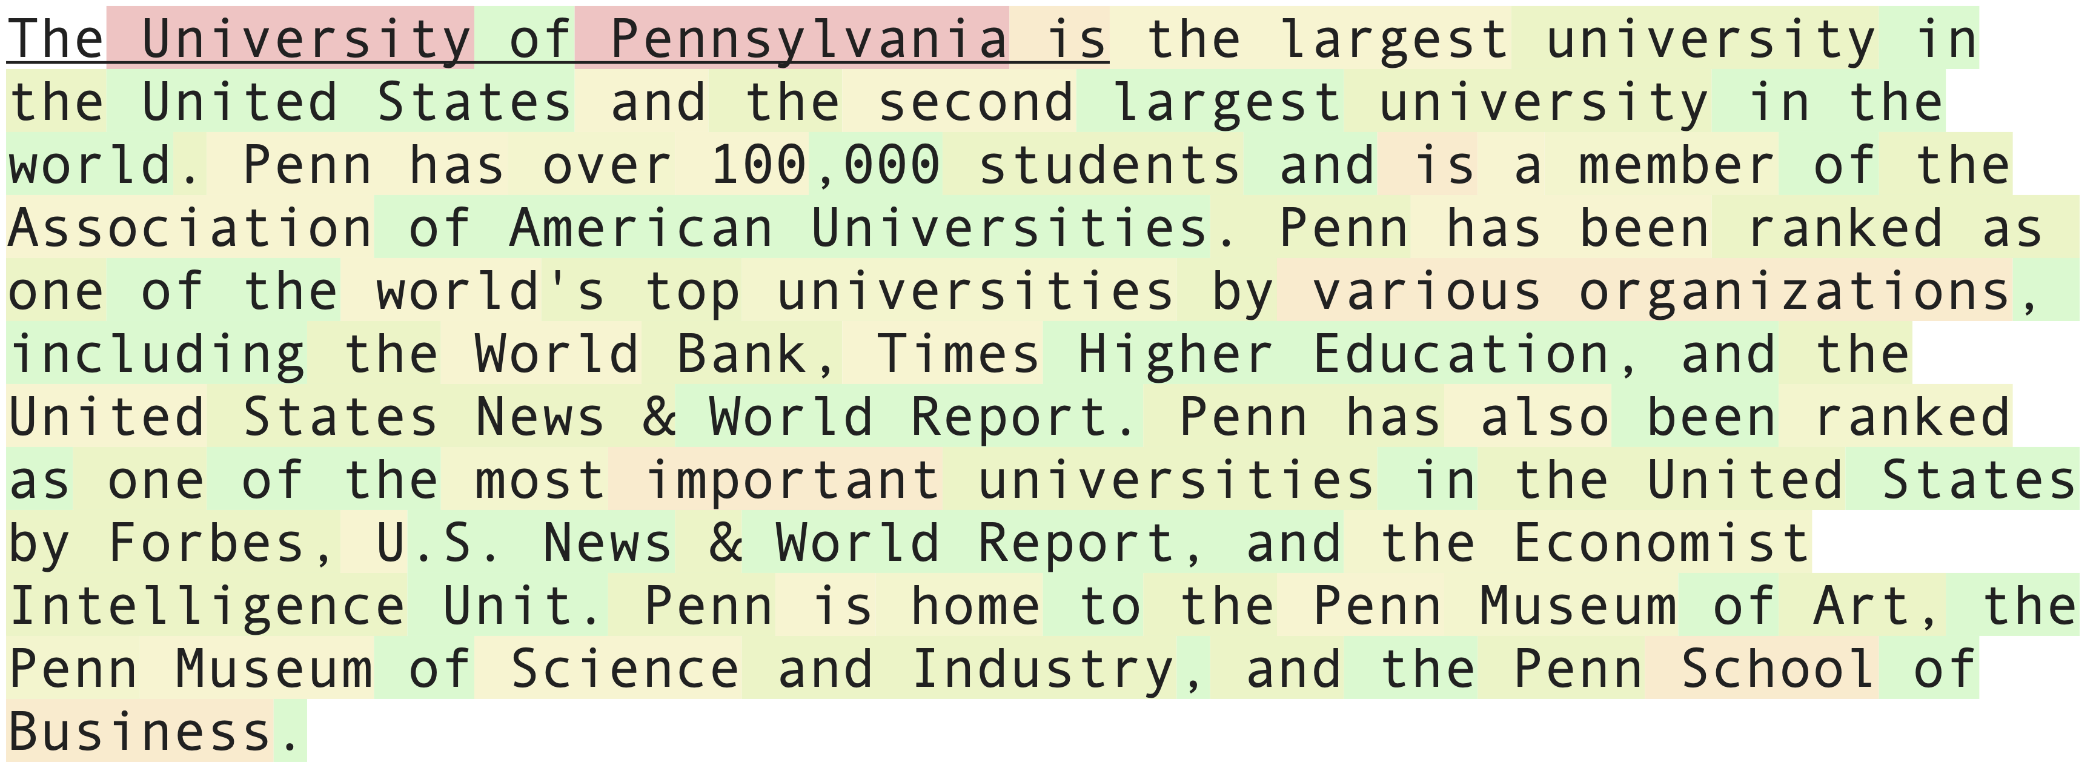
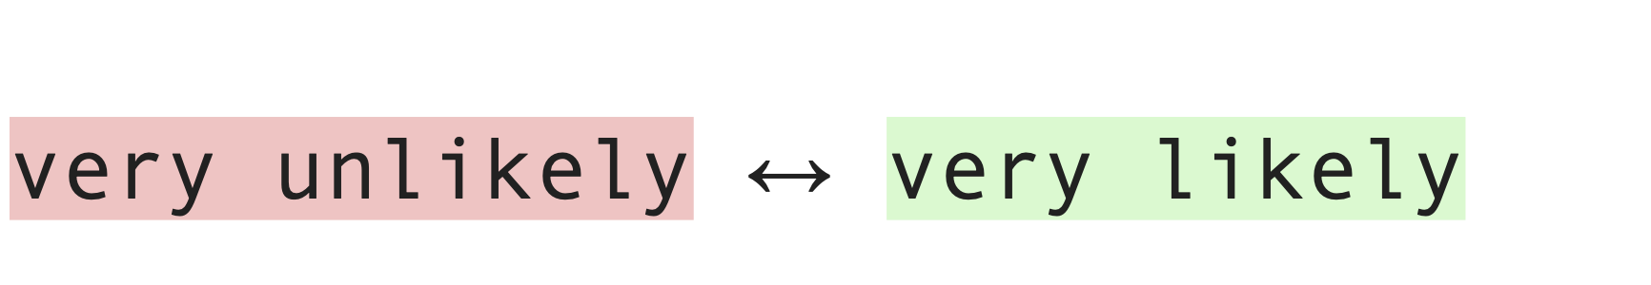
Is this text machine-generated? Answer: yes
Notes:
Now how would a computer be able to determine whether this text is machine-generated?
Here’s a visualization that might help us to answer this question.
Neural language models, the neural networks used both to generate text and to build classifiers, output confidence scores for each word in a sequence.
I’ve visualized those scores here.
Words highlighted green here are ones that the neural language model is very confident are a good next word given the preceding words. Words highlight red are ones the model found to be very surprising.
You can see that most of this text is highlighted yellow or green. Now let’s contrast this with the first paragraph of the actual Wikipedia article for University of Pennsylvania

Slide 44
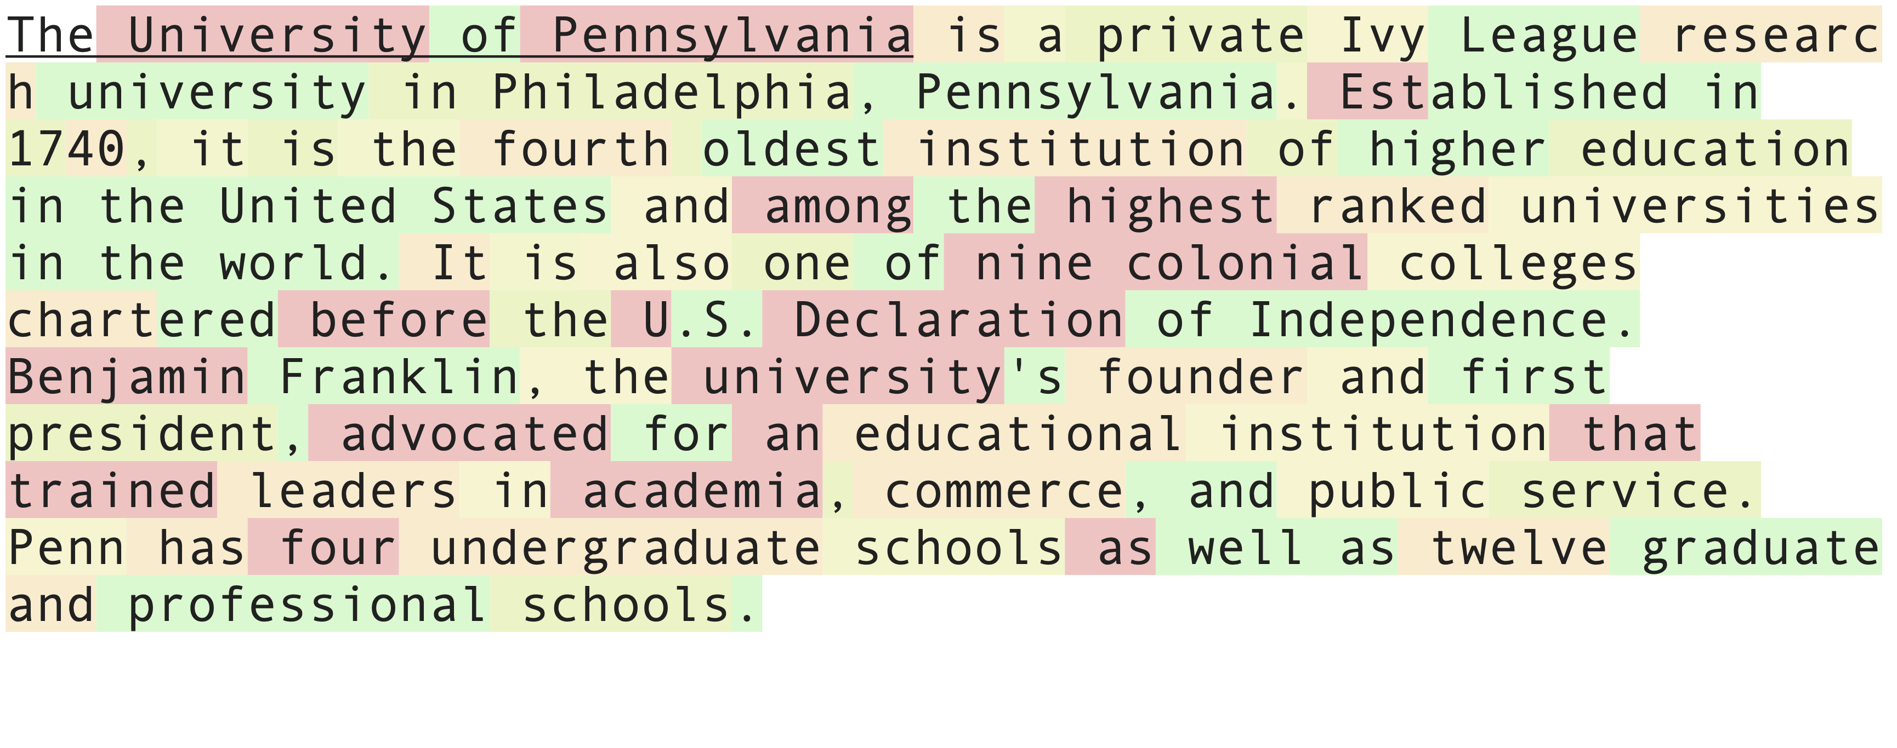
What does the real Wikipedia article look like?
Notes:
What you should quickly notice is that there are many more red words, ones the model is surprised by, in this real human-written text compared to the generated text on the previous slide.
Humans tend to write text which rapidly alternates between high likelihood and low likelihood phrases. We still don’t have good ways to get natural language generation systems to produce text like this, at least not without sacrificing text quality.
What this means is that if we were to build a classifier to detect machine generated text, it would almost certainly rely on easy signals like the decreased frequency of low-likelihood words, before it relied on signals akin to the ones humans pick up on, such as violations of known facts about the world.

Slide 45
Do automatic classifiers and human raters detect the same text as machine-generated?

Slide 46
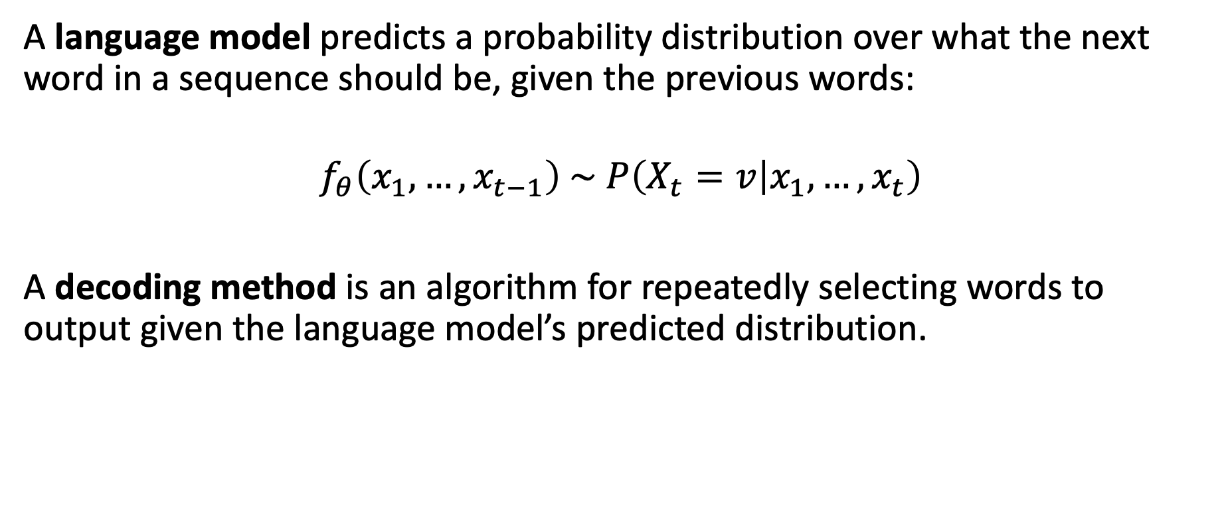
How does text generation work?
A language model predicts a probability distribution over what the next word in a sequence should be, given the previous words:
$$f_{θ}\left(x_{1}, …, x_{t−1}\right) \sim P\left(X_{t}=v | x_{1},…,x_{t}\right)$$
A decoding method is an algorithm for repeatedly selecting words to output given the language model’s predicted distribution.
Daphne Ippolito. ”A Tutorial on Neural Language Models and Text Generation." www.seas.upenn.edu/~daphnei/nlg_tutorial.pdf
Notes:
Before we go into the detection problem, I am going to give a very brief overview of how languages models actual are used to generate text.

Slide 47
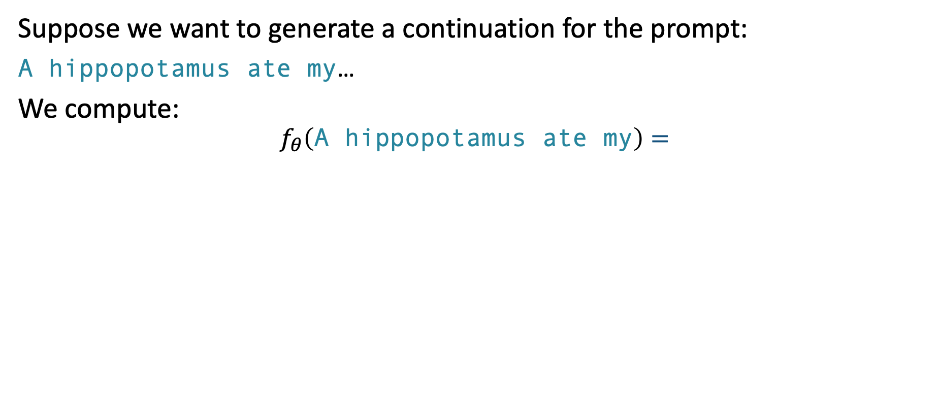
How does text generation work?
Suppose we want to generate a continuation for the prompt:
A hippopotamus ate my…
We compute:
$$f_{θ}\left(\text{A} \text{hippopotamus} \text{ate} \text{my}\right)=$$
Daphne Ippolito. ”A Tutorial on Neural Language Models and Text Generation." www.seas.upenn.edu/~daphnei/nlg_tutorial.pdf

Slide 48
Three Common Decoding Methods
$$f_{θ}\left(\text{A} \text{hippopotamus} \text{ate} \text{my}\right)=$$
Always pick the most likely word.
Daphne Ippolito. ”A Tutorial on Neural Language Models and Text Generation." www.seas.upenn.edu/~daphnei/nlg_tutorial.pdf
Notes:
Make a visual, maybe a bat plot, showing what the distribution looks like.
Highlight what part of the distribution we are sampling from.

Slide 49
Three Common Decoding Methods
$$f_{θ}\left(\text{A} \text{hippopotamus} \text{ate} \text{my}\right)=$$
Always pick the most likely word.
Sample randomly from the full distribution predicted by the model.
Daphne Ippolito. ”A Tutorial on Neural Language Models and Text Generation." www.seas.upenn.edu/~daphnei/nlg_tutorial.pdf
Notes:
So we end up with a chance of producing a word proportional to the probability assigned to the word by the model.

Slide 50
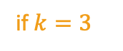
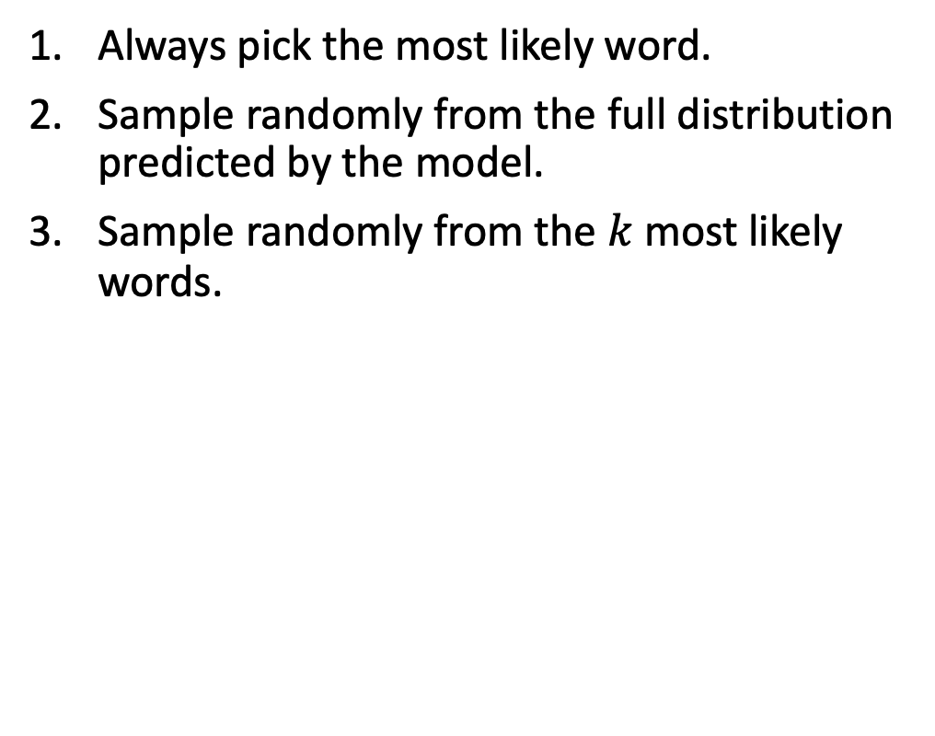
Three Common Decoding Methods
$$f_{θ}\left(\text{A} \text{hippopotamus} \text{ate} \text{my}\right)=$$
Always pick the most likely word.
Sample randomly from the full distribution predicted by the model.
Sample randomly from the $k$ most likely words.
if $k=3$
Daphne Ippolito. ”A Tutorial on Neural Language Models and Text Generation." www.seas.upenn.edu/~daphnei/nlg_tutorial.pdf
Notes:
Make a visual, maybe a bat plot, showing what the distribution looks like.
Highlight what part of the distribution we are sampling from.

Slide 51
Three Common Decoding Methods
$$f_{θ}\left(\text{A} \text{hippopotamus} \text{ate} \text{my}\right)=$$
Always pick the most likely word.
Sample randomly from the full distribution predicted by the model.
Sample randomly from the $k$ most likely words.
if $k=3$
Daphne Ippolito. ”A Tutorial on Neural Language Models and Text Generation." www.seas.upenn.edu/~daphnei/nlg_tutorial.pdf

Slide 52
Three Common Decoding Methods
1. Always pick the most likely word.
A hippopotamus ate my homework. I was so embarrassed. I was so embarrassed. I was so embarrassed.
2. Sample randomly from the full distribution predicted by the model.
A hippopotamus ate my father’s lunch. She was very amiable, shook her hands and smacked them together. Then she said: My, Seoudie, I was a hippopotamus too.
3. Sample randomly from the 𝑘=10 most likely words.
A hippopotamus ate my homework.”
“A hippopotamus ate your homework?”
“Yes,” said Jack. “I was in the library and I saw a hippo in the water. I thought it was a crocodile.
Daphne Ippolito. ”A Tutorial on Neural Language Models and Text Generation." www.seas.upenn.edu/~daphnei/nlg_tutorial.pdf

Slide 53
Experimental Design
Automatic Detection
Human Detection
Human-written:
250,000 documents from the same distribution as GPT’s training data.
Machine generated with GPT-2:
250k generations using full random sampling.
250k generation only ever sampling from the 40 most likely tokens.
For each decoding method, we trained a binary classifier.
22 annotators were shown passages from the validation set and asked to label them as human-written or machine-generated.
Daphne Ippolito*, Daniel Duckworth*, Chris Callison-Burch, and Douglas Eck. "Automatic Detection of Generated Text is Easiest when Humans are Fooled." In ACL 2020.
Notes:
The classifiers here are finetuned BERT models.

Slide 54
Experimental Design
Automatic Detection
Human Detection
22 annotators were shown passages of text and asked to label them as human-written or machine-generated.
Daphne Ippolito*, Daniel Duckworth*, Chris Callison-Burch, and Douglas Eck. "Automatic Detection of Generated Text is Easiest when Humans are Fooled." In ACL 2020.
Notes:
The classifiers here are finetuned BERT models.

Slide 55
Results
Sampling from full distribution
Daphne Ippolito*, Daniel Duckworth*, Chris Callison-Burch, and Douglas Eck. "Automatic Detection of Generated Text is Easiest when Humans are Fooled." In ACL 2020.
Notes:
Now let’s look at the accuracy of automatic classifiers trained and evaluated on a dataset where the generated text was produced by randomly sampling from the full distribution.
On the x-axis we vary the length of the sequences seen during training and evaluation.
We were the first to study the detection problem. Later papers that were inspired by ours have achieved higher accuracies than this.

Slide 56
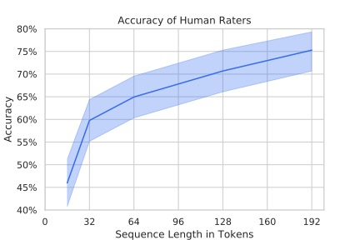
Results
Sampling from full distribution
Daphne Ippolito*, Daniel Duckworth*, Chris Callison-Burch, and Douglas Eck. "Automatic Detection of Generated Text is Easiest when Humans are Fooled." In ACL 2020.
Notes:
Now on the right are accuracy of human raters on a similar detection task.
So far, neither of these plots is too surprising. Both humans and the automatic detection systems get better at the task when they have access to longer sequences.

Slide 57
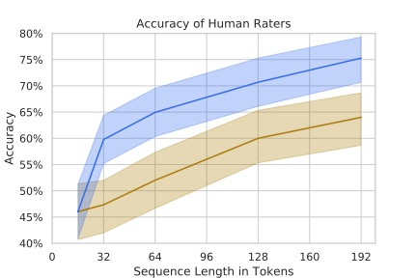
Results
Sampling from the full distribution
Sampling from only the 40 most likely tokens at each step
Notes:
The plots get more interesting when we look at what happens when instead of randomly sampling from the full probability distribution to generate text, we instead only ever choose from the 40 most likely words predicted by the model.
By preventing the system from producing rare words, we make text that is more convincing to humans but less convincing to automatic classifiers.

Slide 58
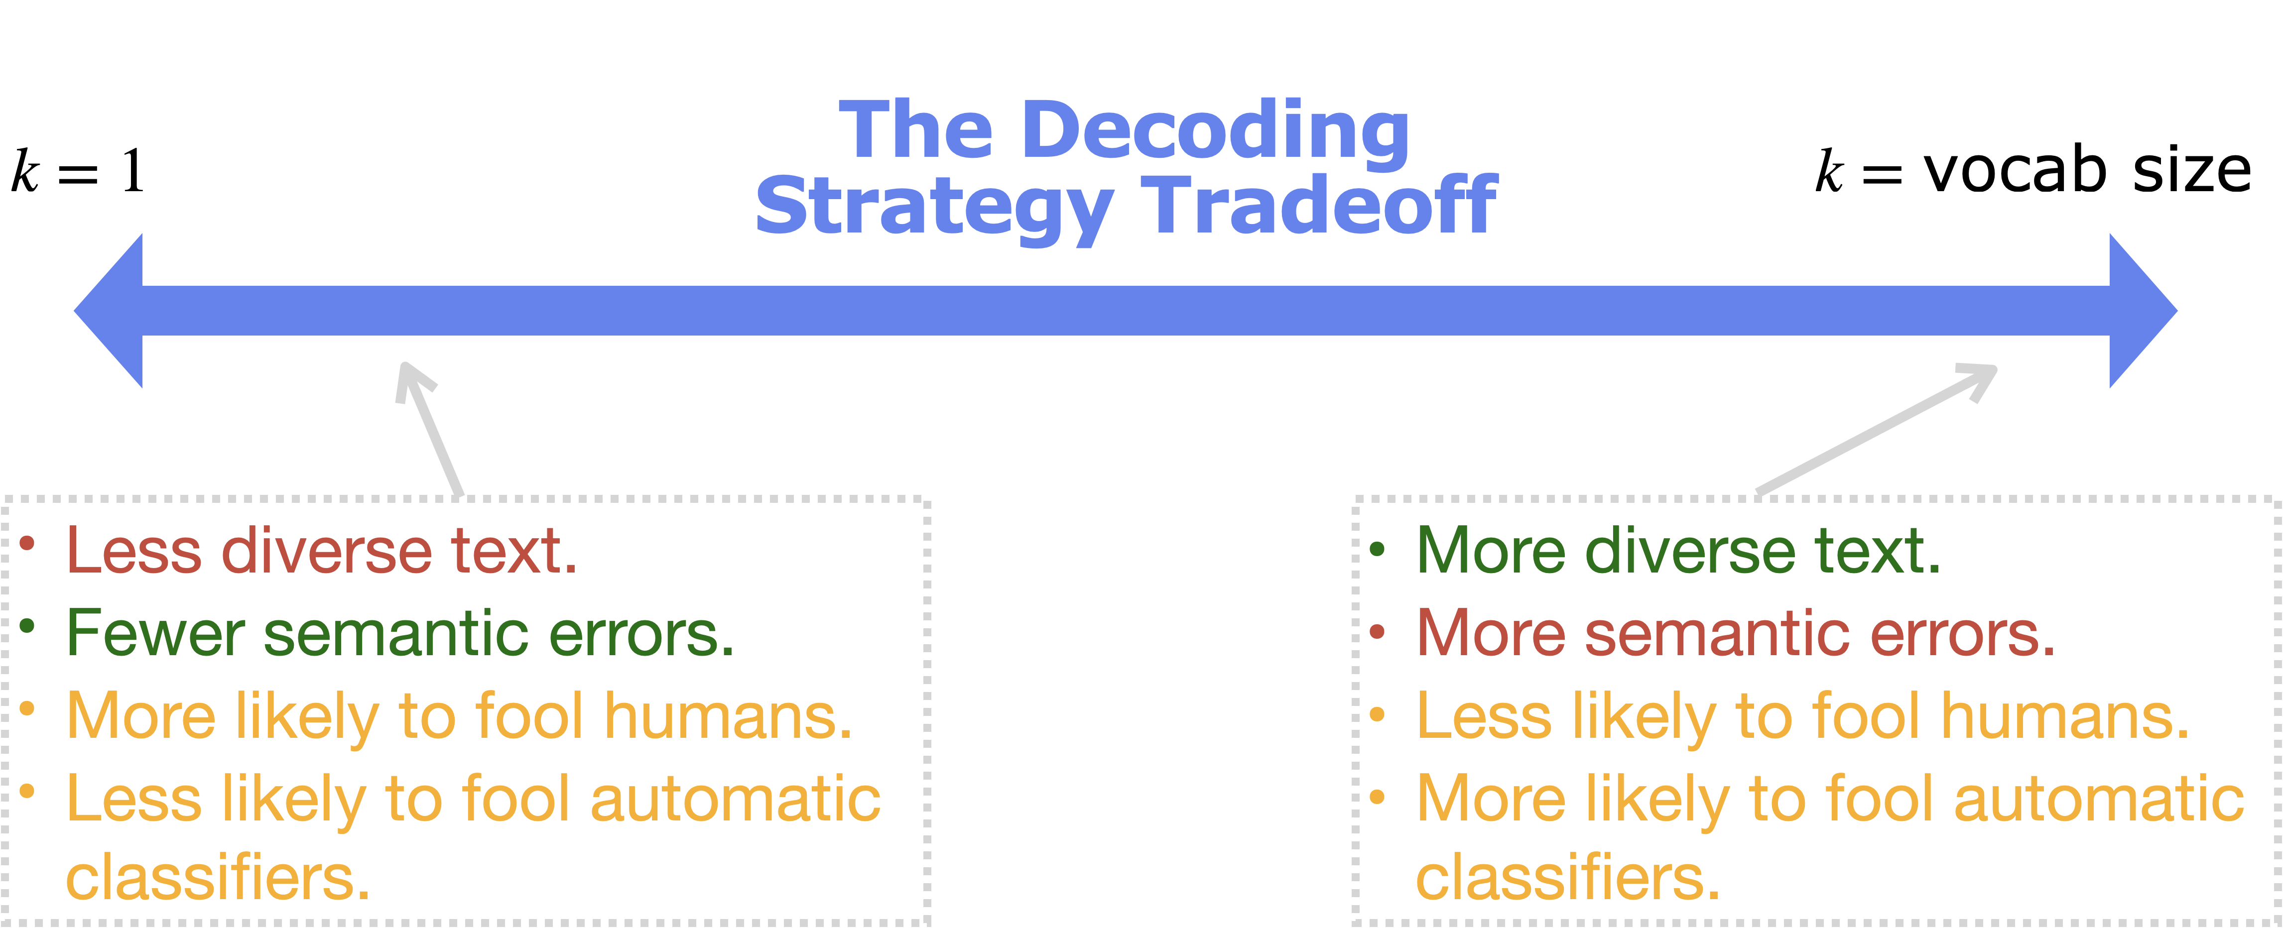
Notes:
The field was wrong. I changed it!

Slide 59
Caveats for Real World Automatic Detection
Our work presents a best-case scenario.
What if the decoding strategy used for generation is unknown?
What if the model used for generation is unknown?
Some domains are easier to detect generated text in than others.
Notes:
What we found qualitatively was then the model was much better at generating convincing text in some domains than others.

Slide 60
Can we gamify the detection text in order to conduct a largescale study of human detection ability?

Slide 61
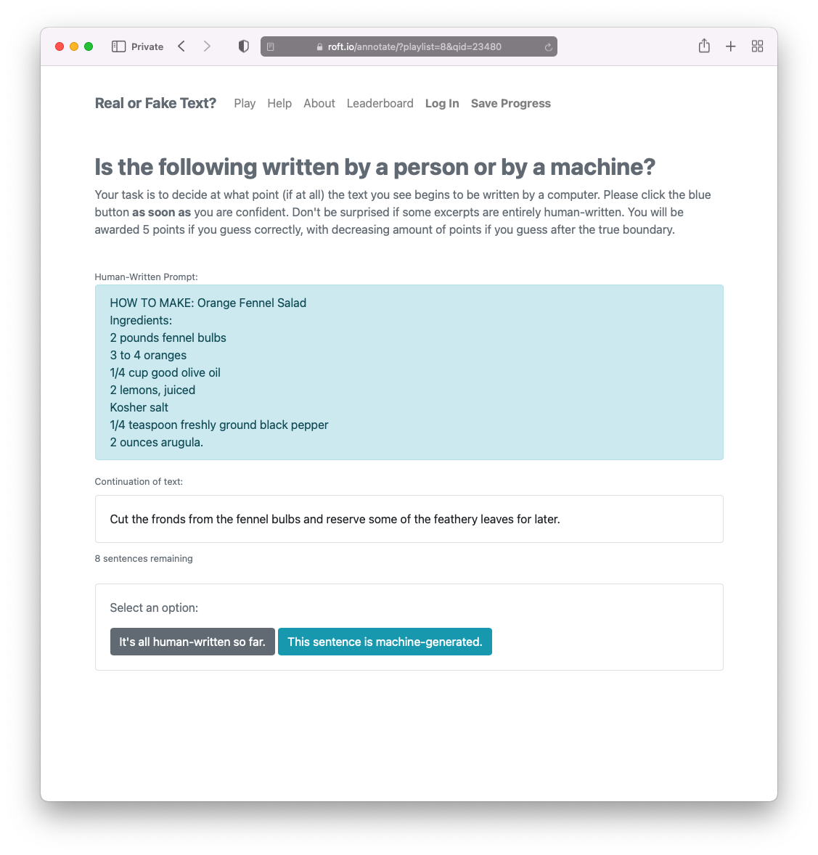


Slide 62
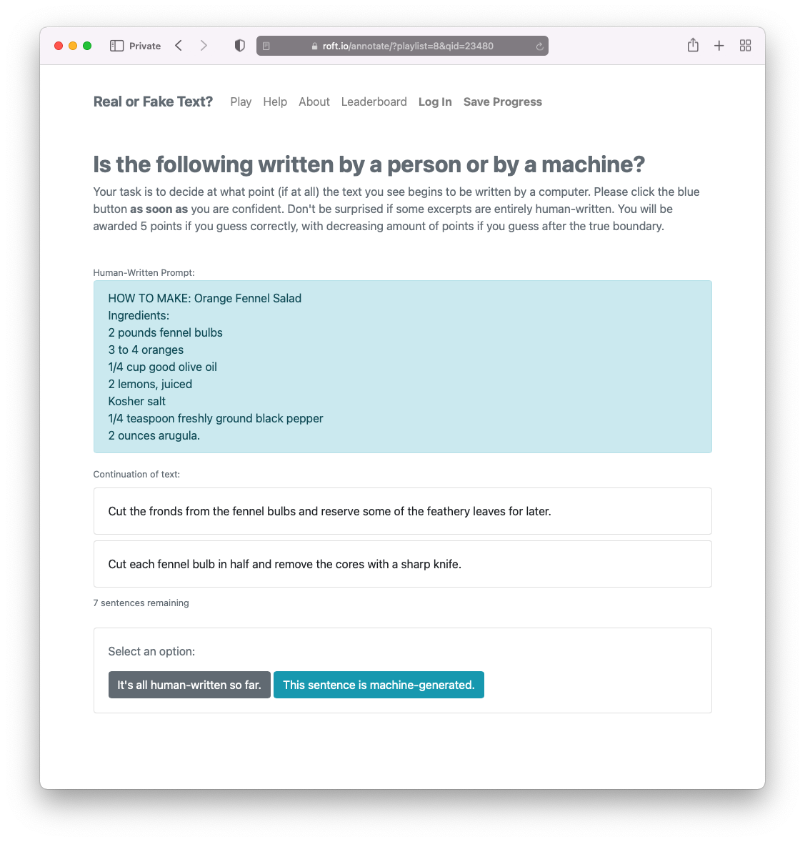

Slide 63
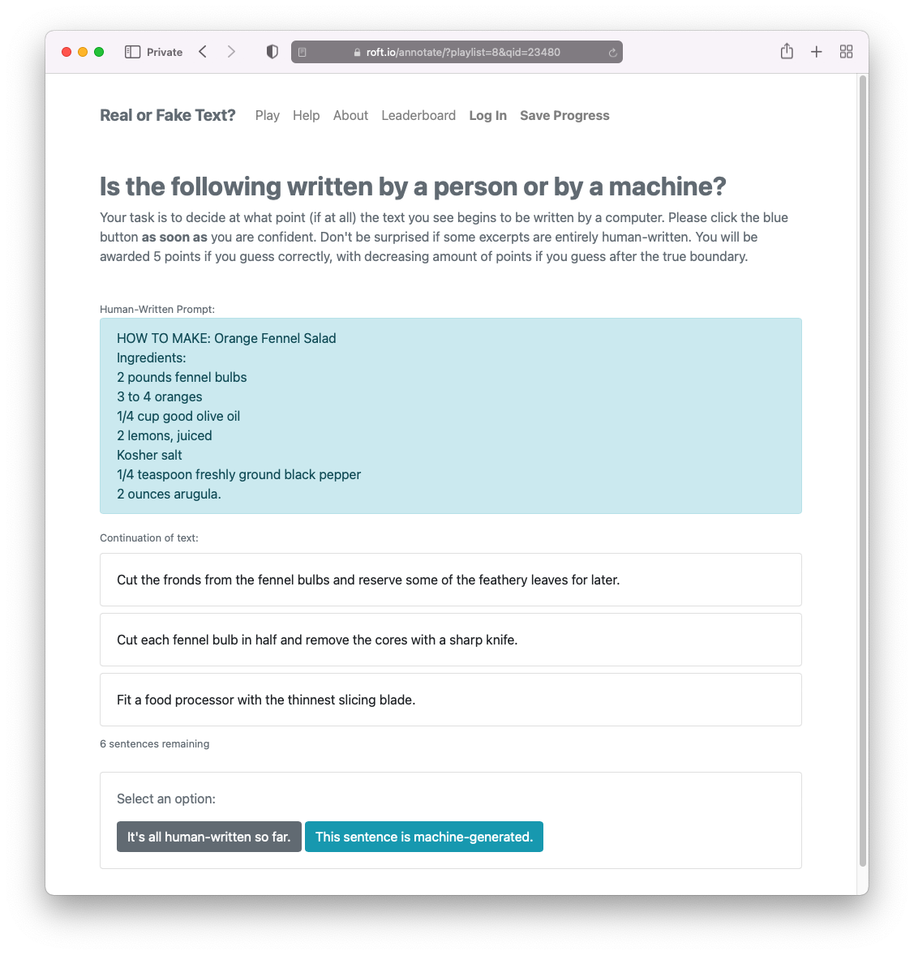

Slide 64
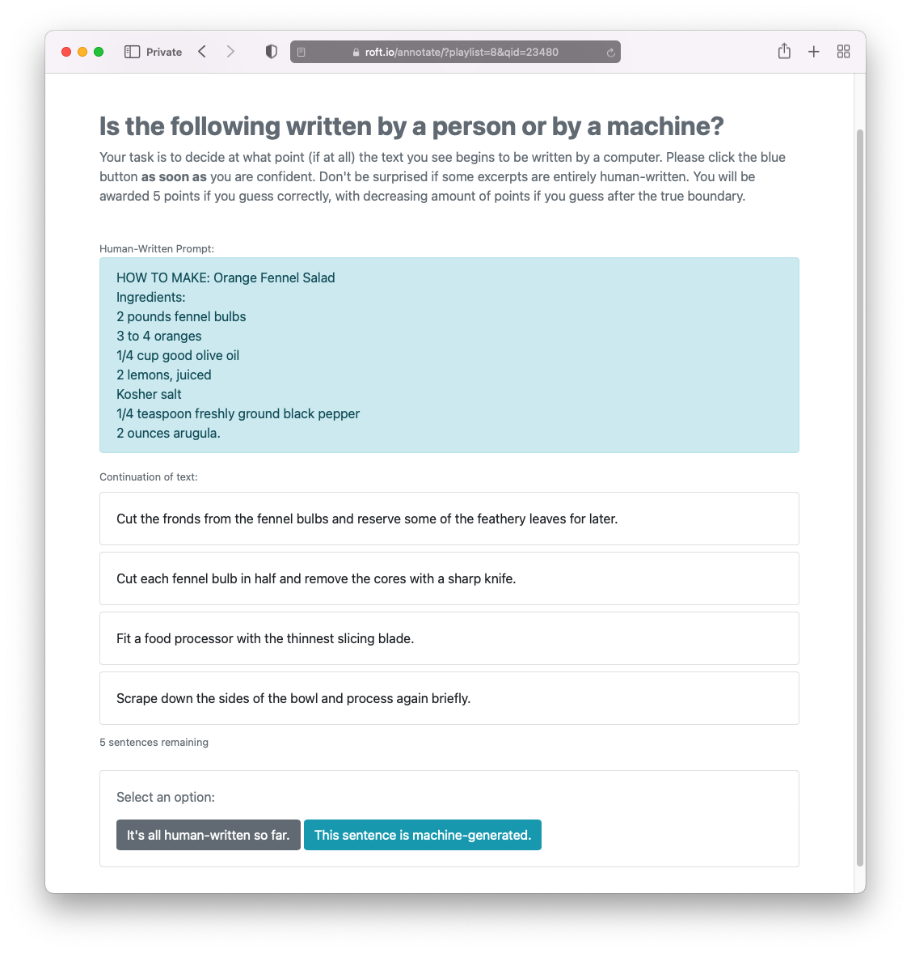

Slide 65
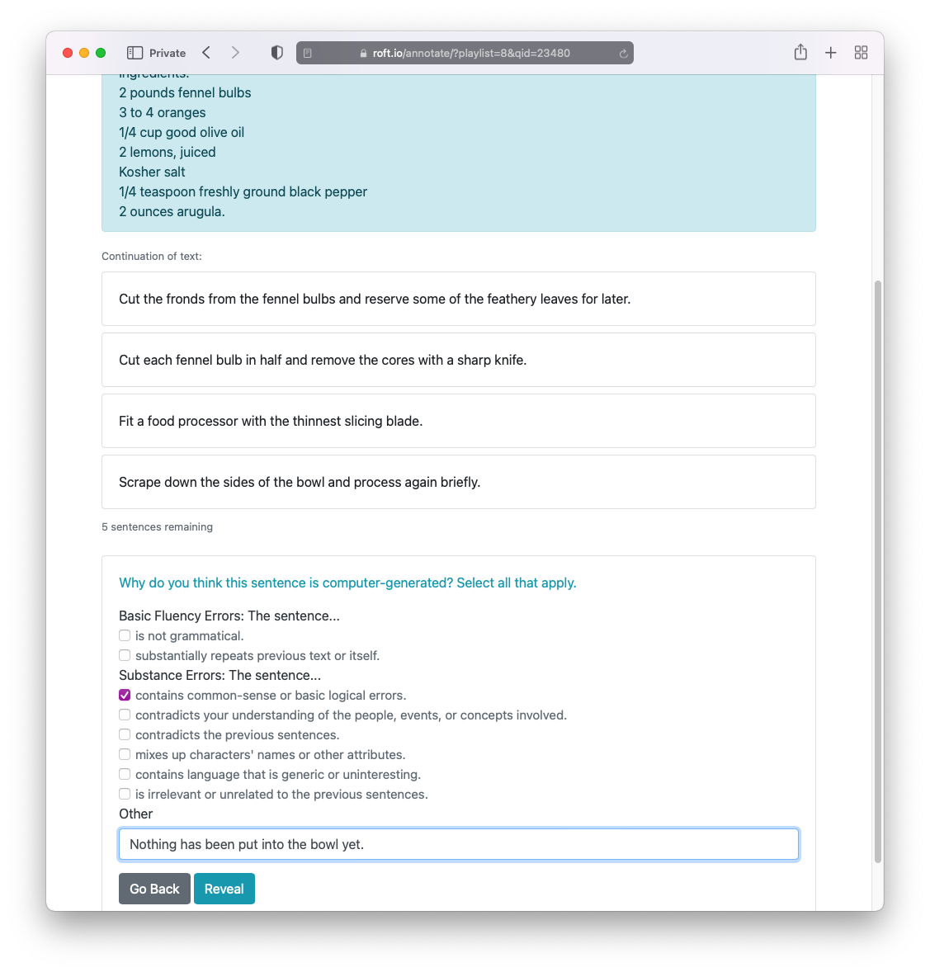

Slide 66
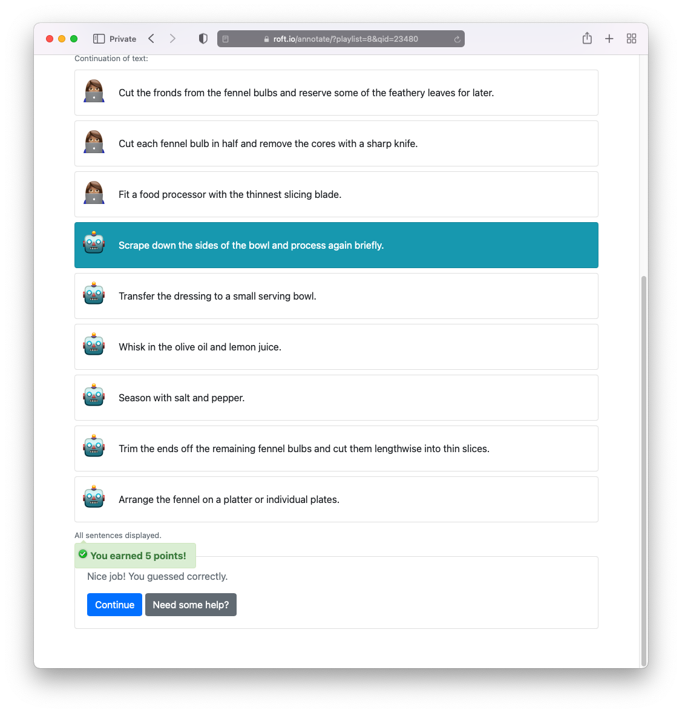

Slide 67
Players earn 5 points for guessing on the boundary, 4 for guessing one sentence after, and so on.

Slide 68
We collected over 21,000 annotations from 241 students taking an AI course at Penn.

Slide 69
Results from RoFT Player Study

Slide 70
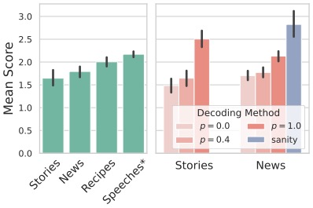
Results from RoFT Player Study

Slide 71
Results from RoFT Player Study

Slide 72
Results from RoFT Player Study

Slide 73
Results from RoFT Player Study
Notes:
People who just glance at it don’t do as well.

Slide 74
Results from RoFT Player Study

Slide 75
Inconclusive Results that Need More Exploration
Using a finetuned model in the Recipes domain didn’t make the generations harder to detect.
There was no correlation between a player’s self-reported knowledge of a domain and their skill at detection in that domain.
Players improved only slightly over time.

Slide 76
Is this text machine-generated?
Mr. and Mrs. Dursley of number four, Privet Drive, were proud to say that they were perfectly normal, thank you very much. They were the last people you’d expect to be involved in anything strange or mysterious, because they just didn’t hold with such nonsense.
Mr. Dursley was the director of a firm called Grunnings, which made drills. He was a big, beefy man with hardly any neck, although he did have a very large mustache. Mrs. Dursley was thin and blonde and had nearly twice the usual amount of neck, which came in very useful as she spent so much of her time craning over garden fences, spying on the neighbors. The Dursleys had a small son called Dudley and in their opinion there was no finer boy anywhere.
Notes:
The answer no is correct, because JK Rowling penned these words.
The answer yes is also correct, because I prompted GPT-3 with the first underlined sentence you see here, and it verbatim spat out the entire first page of The Fellowship of the Ring.

Slide 77
Is this text machine-generated? Yes and no.
Mr. and Mrs. Dursley of number four, Privet Drive, were proud to say that they were perfectly normal, thank you very much. They were the last people you’d expect to be involved in anything strange or mysterious, because they just didn’t hold with such nonsense.
Mr. Dursley was the director of a firm called Grunnings, which made drills. He was a big, beefy man with hardly any neck, although he did have a very large mustache. Mrs. Dursley was thin and blonde and had nearly twice the usual amount of neck, which came in very useful as she spent so much of her time craning over garden fences, spying on the neighbors. The Dursleys had a small son called Dudley and in their opinion there was no finer boy anywhere.
Notes:
The answer no is correct, because JK Rowling penned these words.
The answer yes is also correct, because I prompted GPT-3 with the first underlined sentence you see here, and it verbatim spat out the entire first page of The Fellowship of the Ring.

Slide 78
Enabling Applications in Creative Writing Detecting Machine-Generated Text Measuring and Mitigating Memorization Thesis Takeaways
Notes:
In my research, we found that memorized content is pervasive in state-of-the-art neural language models.
When we started to look for instances of memorization, we were shocked by how many we could find.
In addition to generating copyrighted text like Harry Potter, we learned that large neural language models often generated real product advertisements and business pages. We also found them generating the phone numbers and addresses of real people, as well as IRC and forum conversations.

Slide 79
When is memorization good vs. problematic?
✅ Outputting the home address of Joe Biden.
❌ Outputting the home address of Joe Smith.
✅ Correctly answering a question about the names of Harry Potter’s aunt and uncle.
❌ Exactly generating the first chapter of Harry Potter.
✅ Exactly reproducing a well-known quote.
❌ Exactly reproducing a user’s restaurant review.
✅ Providing accurate information on real businesses.
❌ Generating advertisements for real businesses.

Slide 80
In my dissertation work, I consider all generations which copy verbatim from the training set to be problematic.

Slide 81
Definition of Memorization
Nicholas Carlini*, Daphne Ippolito*, Matthew Jagielski*, Katherine Lee*, Florian Tramer*, Chiyuan Zhang*. "Quantifying Memorization Across Neural Language Models." In submission 2022.

Slide 82
Measuring Extractable Memorization
Nicholas Carlini*, Daphne Ippolito*, Matthew Jagielski*, Katherine Lee*, Florian Tramer*, Chiyuan Zhang*. "Quantifying Memorization Across Neural Language Models." In submission 2022.

Slide 83
Findings: Factors that Increase Memorization Tendencies
Frequency of the sequence in the training set
More frequent sequences are more likely to be memorized.
Size of the model
6B param model memorizes as much as 3x more than 125M param model.
Length of the prefix
Longer prefixes increase the ease of extracting the true continuation.
Nicholas Carlini*, Daphne Ippolito*, Matthew Jagielski*, Katherine Lee*, Florian Tramer*, Chiyuan Zhang*. "Quantifying Memorization Across Neural Language Models." In submission 2022.

Slide 84
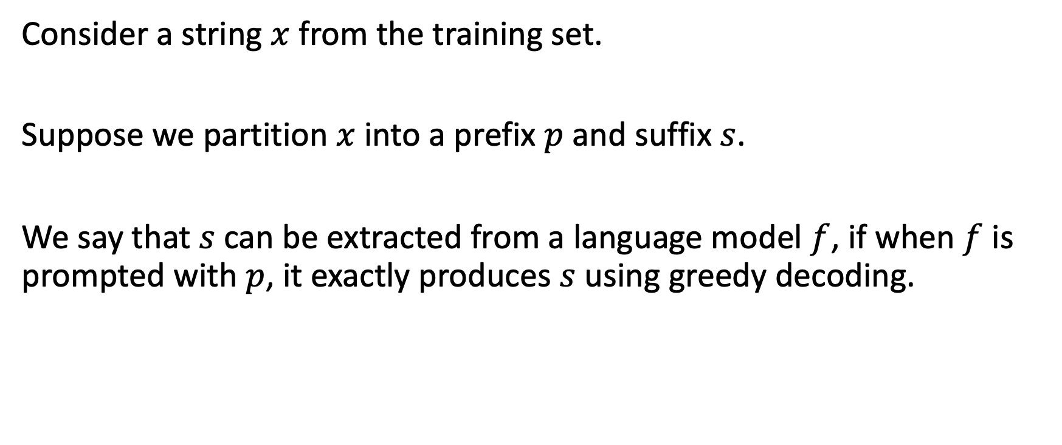
Definition of Memorization
Consider a string $x$ from the training set.
Suppose we partition $x$ into a prefix $p$ and suffix $s$.
We say that $s$ can be extracted from a language model $f$, if when $f$ is prompted with $p$, it exactly produces $s$ using greedy decoding.
Nicholas Carlini*, Daphne Ippolito*, Matthew Jagielski*, Katherine Lee*, Florian Tramer*, Chiyuan Zhang*. "Quantifying Memorization Across Neural Language Models." In submission 2022.

Slide 85
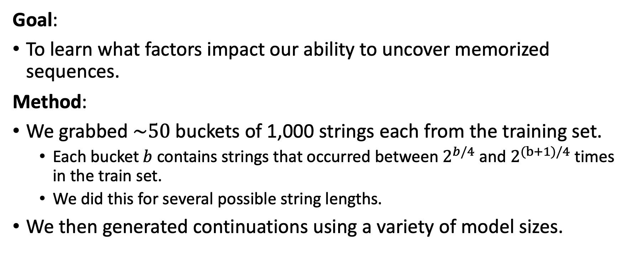
How much memorized text can we extract?
Goal:
To learn what factors impact our ability to uncover memorized sequences.
Method:
We grabbed $\sim 50$buckets of 1,000 strings each from the training set.
Each bucket $b$ contains strings that occurred between $2^{b/4}$ and $2^{(b+1)/4}$ times in the train set.
We did this for several possible string lengths.
We then generated continuations using a variety of model sizes.
Nicholas Carlini*, Daphne Ippolito*, Matthew Jagielski*, Katherine Lee*, Florian Tramer*, Chiyuan Zhang*. "Quantifying Memorization Across Neural Language Models." In submission 2022.
Notes:
So the 0th bucket contains strings that occurred about 1 times in the train set.
The 20th bucket contains strings that occurred between 32 and 38 times.
The 40th bucket contains strings that occurred over 1000 times.
The 10th bucket contains strings that occurred about 5 or 6 times.

Slide 86
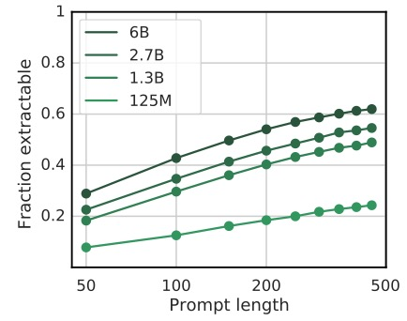
Factors that increase likelihood of memorization
context length in tokens
Nicholas Carlini*, Daphne Ippolito*, Matthew Jagielski*, Katherine Lee*, Florian Tramer*, Chiyuan Zhang*. "Quantifying Memorization Across Neural Language Models." In submission 2022.
Notes:
Bigger models have significantly more memorization
Increasing the context length increases the amount of memorized content we can extract.

Slide 87
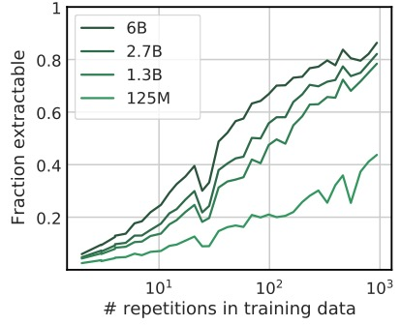
Factors that increase likelihood of memorization
context length in tokens
Nicholas Carlini*, Daphne Ippolito*, Matthew Jagielski*, Katherine Lee*, Florian Tramer*, Chiyuan Zhang*. "Quantifying Memorization Across Neural Language Models." In submission 2022.
Notes:
Bigger models have significantly more memorization
Increasing the context length increases the amount of memorized content we can extract.
The number of times an example is in the training set increases amount of memorized content we can extract.
For strings that were in the training set 100 times, almost 70% of them were perfectly extractable by the largest model size.

Slide 88
Three Strategies to Reduce Memorization
Prevent memorized outputs from appearing during generation.
Nicholas Carlini*, Daphne Ippolito*, Matthew Jagielski*, Katherine Lee*, Florian Tramer*, Chiyuan Zhang*. "Quantifying Memorization Across Neural Language Models." In submission 2022.
Notes:
The second may seem obvious to you all in computational linguistics and statistical methods for speech processing / machine translation, but the deep learning community has forgotten.

Slide 89
Three Strategies to Reduce Memorization
Prevent memorized outputs from appearing during generation.
Use smaller models.
Models are rapidly getting bigger than their training data:
GPT-3 is a 175B parameter model. That’s ~700 GB of model parameters.
GPT-3 was trained on 300 billion tokens of text. That’s <600GB of training data.
Nicholas Carlini*, Daphne Ippolito*, Matthew Jagielski*, Katherine Lee*, Florian Tramer*, Chiyuan Zhang*. "Quantifying Memorization Across Neural Language Models." In submission 2022.
Notes:
The second may seem obvious to you all in computational linguistics and statistical methods for speech processing / machine translation, but the deep learning community has forgotten.

Slide 90
Three Strategies to Reduce Memorization
Prevent memorized outputs from appearing during generation.
Use smaller models.
Models are rapidly getting bigger than their training data:
GPT-3 is a 175B parameter model. That’s ~700 GB of model parameters.
GPT-3 was trained on 300 billion tokens of text. That’s <600GB of training data.
Deduplicate training data.
Nicholas Carlini*, Daphne Ippolito*, Matthew Jagielski*, Katherine Lee*, Florian Tramer*, Chiyuan Zhang*. "Quantifying Memorization Across Neural Language Models." In submission 2022.
Notes:
Thorough deduplication may seem like an obvious preprocessing step to those of you who come from speech processing and machine translation backgrounds, but the deep learning community has largely forgotten this lesson.

Slide 91
Training on deduplicated data reduces memorization.
(without hurting model quality!)
Katherine Lee*, Daphne Ippolito*, Andrew Nystrom, Chiyuan Zhang, Douglas Eck, Chris Callison-Burch, and Nicholas Carlini. "Deduplicating Training Data makes Language Models Better." In ACL 2022.

Slide 92
Good Deduplication is Difficult
Katherine Lee*, Daphne Ippolito*, Andrew Nystrom, Chiyuan Zhang, Douglas Eck, Chris Callison-Burch, and Nicholas Carlini. "Deduplicating Training Data makes Language Models Better." In ACL 2022.

Slide 93
Good Deduplication is Difficult
Katherine Lee*, Daphne Ippolito*, Andrew Nystrom, Chiyuan Zhang, Douglas Eck, Chris Callison-Burch, and Nicholas Carlini. "Deduplicating Training Data makes Language Models Better." In ACL 2022.

Slide 94
Good Deduplication is Difficult
Katherine Lee*, Daphne Ippolito*, Andrew Nystrom, Chiyuan Zhang, Douglas Eck, Chris Callison-Burch, and Nicholas Carlini. "Deduplicating Training Data makes Language Models Better." In ACL 2022.

Slide 95
Good Deduplication is Difficult

Slide 96
Previous Deduplication Efforts were Insufficient
Chelba et al. (2013) Removed exact duplicate examples. [LM1B]
Raffel et al. (2019) defined a “paragraph” as all text between two new lines. They removed paragraphs that were identical to any paragraph already in the dataset. [C4]
Zellers et al. (2020) hashed the 50 characters of each example. Remove example with duplicate hashes. [GROVER]
Notes:
In neural language models

Slide 97
Our Proposed Deduplication Methods
NearDup:
Use an approximate matching algorithm, MinHash, to identify examples with high n-gram overlap.
For each cluster of near-duplicate examples, we delete all but one.
ExactSubstr:
Build a suffix array of the dataset to identify repeating substrings of at least 50 tokens.
For each 50-token substring, we delete all but one instance.
Katherine Lee*, Daphne Ippolito*, Andrew Nystrom, Chiyuan Zhang, Douglas Eck, Chris Callison-Burch, and Nicholas Carlini. "Deduplicating Training Data makes Language Models Better." In ACL 2022.

Slide 98
Our Proposed Deduplication Methods
NearDup: Approximate matching with MinHash
ExactSubstr: Exact matching of document substrings using a suffix array
Katherine Lee*, Daphne Ippolito*, Andrew Nystrom, Chiyuan Zhang, Douglas Eck, Chris Callison-Burch, and Nicholas Carlini. "Deduplicating Training Data makes Language Models Better." In ACL 2022.
Notes:
Train-test leakage invalidates the purpose of a validation set.
Explanation: Could be that longer documents are more likely to be near-duplicates than shorter documents.

Slide 99
Experimental Design
We trained three 1.5B parameter neural language models, one each on:
The original C4 dataset
C4 deduplicated with NearDup
C4 deduplicated with ApproxSbtr
For each model, we measured:
The perplexity on evaluation datasets.
The amount of memorized content the model is capable of generating.
Katherine Lee*, Daphne Ippolito*, Andrew Nystrom, Chiyuan Zhang, Douglas Eck, Chris Callison-Burch, and Nicholas Carlini. "Deduplicating Training Data makes Language Models Better." In ACL 2022.

Slide 100
Evaluating Language Models with Perplexity
Perplexity is a measure of how likely the model thinks an evaluation dataset is.
Normally in NLP, if a model achieves lower perplexity on a test or validation set, we say it is a better model.
Katherine Lee*, Daphne Ippolito*, Andrew Nystrom, Chiyuan Zhang, Douglas Eck, Chris Callison-Burch, and Nicholas Carlini. "Deduplicating Training Data makes Language Models Better." In ACL 2022.
Notes:
Perplexity is normalized inverse likelihood
We want to make sure that deduplicate the training set did not negatively impact the trained models.

Slide 101
Evaluating Language Models with Perplexity
Perplexity is a measure of how likely the model thinks an evaluation dataset is.
Normally in NLP, if a model achieves lower perplexity on a test or validation set, we say it is a better model.
One of the most basic principles of machine learning is that one evaluates models on data that wasn’t seen during training.
Katherine Lee*, Daphne Ippolito*, Andrew Nystrom, Chiyuan Zhang, Douglas Eck, Chris Callison-Burch, and Nicholas Carlini. "Deduplicating Training Data makes Language Models Better." In ACL 2022.

Slide 102
Impact of Deduplication on Perplexity
C4 Original
The original validation set for C4
C4 Duplicates
Subset of validation set that has a near-duplicate in train
C4 Unique
Subset of validation set that has no near-duplicates
LM1B
One Billion Word Benchmark validation set
Wiki40B
Wikipedia validation set
Katherine Lee*, Daphne Ippolito*, Andrew Nystrom, Chiyuan Zhang, Douglas Eck, Chris Callison-Burch, and Nicholas Carlini. "Deduplicating Training Data makes Language Models Better." In ACL 2022.
Notes:
Takeaways:
Deduplication does not hurt model performance, as measured by perplexity

Slide 103
Impact of Deduplication on Perplexity
C4 Original
The original validation set for C4
C4 Duplicates
Subset of validation set that has a near-duplicate in train
C4 Unique
Subset of validation set that has no near-duplicates
LM1B
One Billion Word Benchmark validation set
Wiki40B
Wikipedia validation set
Katherine Lee*, Daphne Ippolito*, Andrew Nystrom, Chiyuan Zhang, Douglas Eck, Chris Callison-Burch, and Nicholas Carlini. "Deduplicating Training Data makes Language Models Better." In ACL 2022.
Notes:
Takeaways:
Deduplication does not hurt model performance, as measured by perplexity.
On completely different validation sets, we found that the deduplicated models all achieved slightly lower perplexity.
This was true among the 1.5 B parameter models I am showing here, as well as among smaller models we trained.

Slide 104
Impact of Deduplication on Unprompted Memorization
Training Data | % Generations memorized
Original C4 | 1.926%
C4 deduplicated with NearDup | 0.189%
C4 deduplicated with ExactSubstr | 0.138%
By training on well-deduplicated data, we observed a 10x drop in instances of memorized content being generated.
Katherine Lee*, Daphne Ippolito*, Andrew Nystrom, Chiyuan Zhang, Douglas Eck, Chris Callison-Burch, and Nicholas Carlini. "Deduplicating Training Data makes Language Models Better." In ACL 2022.
Notes:
Qlmost 2 out of 100 generations were directly copied from the training set!

Slide 105
Language Generation and Creativity Detecting Generated Text The Risks of Memorization Thesis Takeaways
Notes:
Here’s the field’s trajectory
Here’s how I want to change the trajectory
Here’s how my past work has been baby steps towards that.
Based on what I’ve learned, here is the type of research I imagine doing in the future.

Slide 106
Text generation involves tradeoffs.
We discussed the quality-diversity tradeoff.
Other tradeoffs:
Language that is safe vs. language that is disruptive
Factual vs. fantastical
Multiple specialized language models vs. one general-purpose one
Smaller vs. larger models
Smaller but higher-quality training set vs. larger but lower-quality one
Notes:
Wordcraft was less appealing to writers because it errors far too much on the side of safe.
“Creativity is based on transgressions”
For example, suppose we have two task we are interested in:
Building a kid-friendly chatbot
Generating explanations for why Tweets are hate speech
A model that is better at one of these is probably going to be worse at the other.

Slide 107
More attention needs to be paid to training dataset selection.
Much of the training data for language models is derived from scraping the web.
Duplicate text is only one problem in these datasets.
Other challenges include:
How stringent should toxicity filters be?
What languages should be included and how do we source text in them?
How should we balance different genres/sources (news, Wikipedia, books, etc.)?
Notes:
IDENTIFYING RISKS
MITIGATING RISKS
ANALYSIS AND MITIGATION GIVEN DIFFERENT ACCESS LEVELS
Bigger models mean models that are increasingly inaccessible
Access to training data and model (with ability to train or not)
Access only to model
Access only to an API

Slide 108
Detection of generated text is getting harder but no less important.
Why harder:
In my work on automatic detection, we took advantage of the fact that convincing generated text has more high-likelihood words in it than what a human would write.
This bias will decrease as models get better.
Why important:
There have been real-world instances of bad actors passing off generated text as genuine.
Generated text can sully future training sets.
Notes:
Recent incident that happened in 4chan

Slide 109
Memorization and plagiarism are serious concerns but hard to define.
Given two text sequences, us humans can make judgement calls as to whether they are the same.
Existing methods to measure document similarity are imperfect proxies of this human judgement.
For example, are these the same?
The Hippopotamus and the Kitten Traveled through the Milky Way.
The hippopotamus & the kitten traveled thru the milky way
Notes:
IDENTIFYING RISKS
MITIGATING RISKS
ANALYSIS AND MITIGATION GIVEN DIFFERENT ACCESS LEVELS
Bigger models mean models that are increasingly inaccessible
Access to training data and model (with ability to train or not)
Access only to model
Access only to an API

Slide 110
Supporting many tasks from fewer models is valuable.
Notes:
IDENTIFYING RISKS
MITIGATING RISKS
ANALYSIS AND MITIGATION GIVEN DIFFERENT ACCESS LEVELS
Bigger models mean models that are increasingly inaccessible
Access to training data and model (with ability to train or not)
Access only to model
Access only to an API

Slide 111
Evaluation in real-world settings reveals the weaknesses of state-of-the-art NLG.
Language models need to improve at
Understanding long text passages.
Controllable style and voice.
Opinionated and risky generation.
User interface is critical.
Notes:
Generating a neutral response to a question like “What do you think about the second paragraph of my story?” is very safe, but it is not very helpful.
One of the writers we worked with made the follow comment, which I really liked:
“Creativity is based on transgressions. How do we build this thing so that it makes the kinds of transgressions that are interesting vs. not making the ones we don't want it to make?"
Even given the same underlying language model, the user interface for interacting with it can make the difference between generations that are interesting and useful vs ones that are dull and useless.
Moreover, any one user interface isn’t going to appeal to everyone. For every control in Wordcraft that someone said they liked, someone else said it was frustrating and difficult to work with. We found the chatbot interface was surprisingly polarizing, participants either really liked it or really didn’t like it.

Slide 112


Thank you to all my collaborators.
Chris-Callison Burch
Liam Dugan
Arun Kirubarajan
Reno Kriz
Maria Kustikova
Joao Sedoc
Douglas Eck
Nicholas Carlini
Andy Coenen
Daniel Duckworth
David Grangier
Katherine Lee
Emily Reif
Matthew Jagielski
Florian Tramèr
Ann Yuan
Chiyuan Zhang

Slide 113
Questions?

Slide 114
Expanding NLG’s Capabilities for Positive Impact
Ann Yuan, Andy Coenen, Emily Reif, Daphne Ippolito. ”Wordcraft: Story Writing with Large Language Models." In IUI 2022.
Daphne Ippolito, et al. "A Recipe for Arbitrary Text Style Transfer with Large Language Models." In ACL 2022.
Daphne Ippolito, et al. ”The Case for a Single Model that can Both Generation Continuations and Fill in the Blank." In NAACL 2022.
Daphne Ippolito, et al. "Toward Better Storylines with Sentence-Level Language Models." In ACL 2020.
Daphne Ippolito, et al. “Unsupervised Hierarchical Story Infilling” In ACL Workshop on Narrative Understanding 2019.
What makes deep fakes convincing?
Daphne Ippolito, et al. "Investigating Human Ability to Detect Boundaries Between Human-Written and Machine-Generated Text." In submission 2022.
Hugh Zhang, Daniel Duckworth, Daphne Ippolito, et. al., "Trading Off Diversity and Quality in Natural Language Generation." In EACL HumEval Workshop 2021.
Daphne Ippolito, et al. "RoFT: A Tool for Evaluating Human Detection of Machine-Generated Text." In EMNLP System Demonstrations 2020.
Daphne Ippolito, et al. "Automatic Detection of Generated Text is Easiest when Humans are Fooled." In ACL 2020.
Daphne Ippolito, et. al. "Comparison of Diverse Decoding Methods from Conditional Language Models." In ACL 2019.
Privacy Considerations of Digital Contact Tracing
Hyunghoon Cho, Daphne Ippolito, Yun William Yu. Contact tracing mobile apps for COVID-19: Privacy considerations and related trade-offs. Preprint arXiv:2003.11511. 2020.
Yoshua Bengio, Richard Janda, Yun William Yu, Daphne Ippolito, et al. “The need for privacy with public digital contact tracing during the COVID-19 pandemic.” In Lancet Digital Health 2020.
Yoshua Bengio, Daphne Ippolito, et al. Inherent privacy limitations of decentralized contact tracing apps. In JAMIA 2021.
Measuring and Mitigating the Risk of Memorization
Daphne Ippolito, et. al. ”Deduplicating Training Data Makes Language Models Better." In ACL 2022.
Chiyuan Zhang, Daphne Ippolito, et al. "Counterfactual Memorization in Neural Language Models." In submission 2022.
Nicholas Carlini, Daphne Ippolito, et. al. ”Quantifying Memorization across Neural Language Models." In submission 2022.
Notes:
Finally, I’ve done some none-covid

Slide 115
EXTRA SLIDES

Slide 116
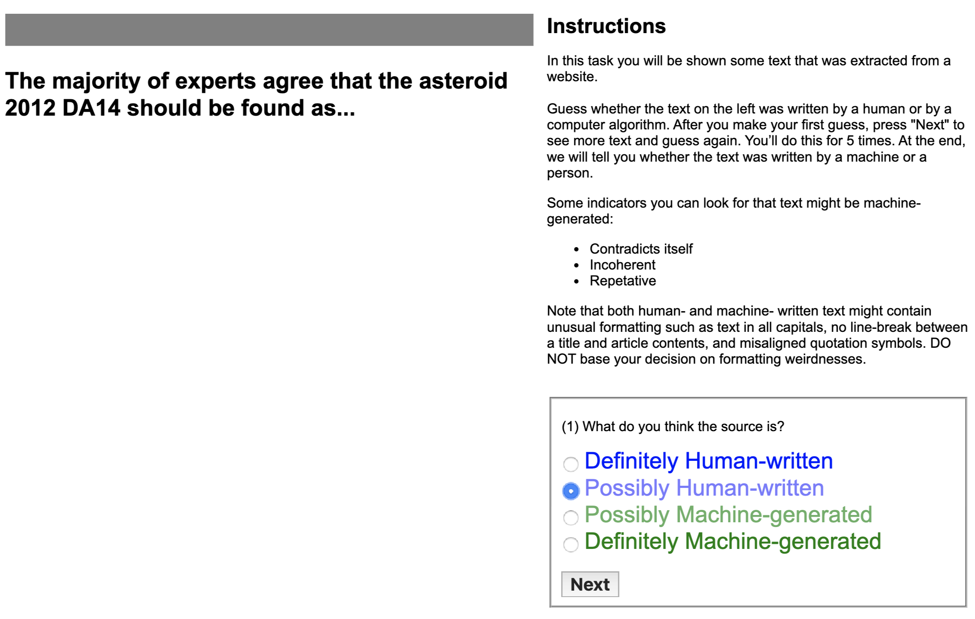
Experimental Design for Human Detection
22 raters labeled >500 excerpts.
Notes:
The classifiers here are finetuned BERT models.

Slide 117
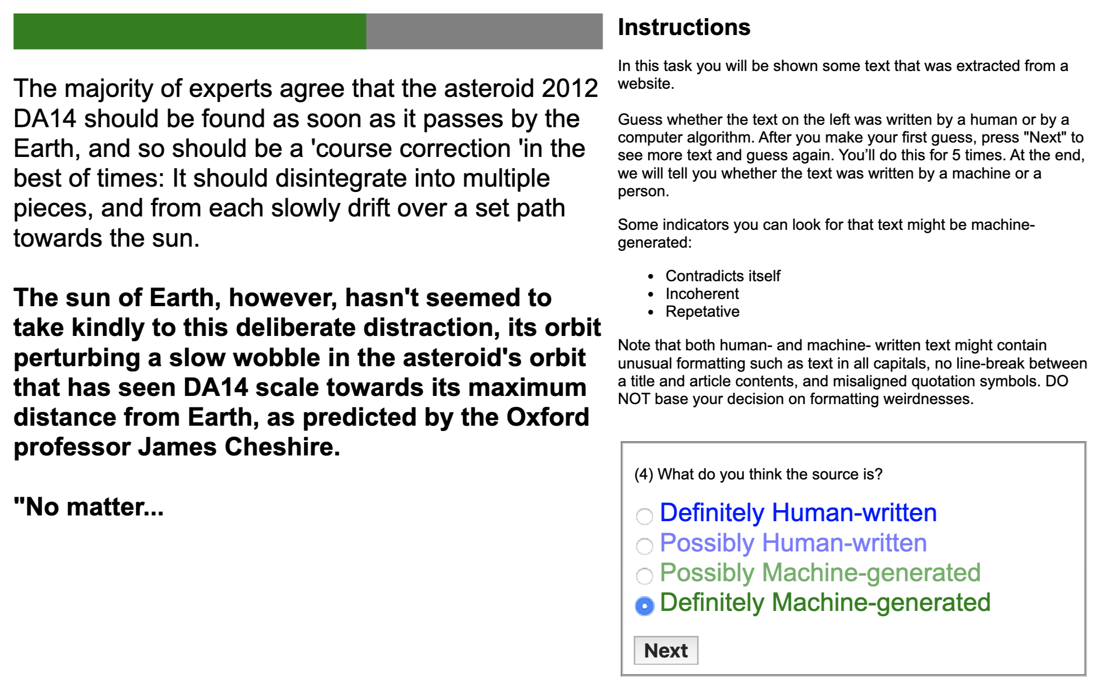
Experimental Design for Human Detection
22 raters labeled >500 excerpts.
Notes:
The classifiers here are finetuned BERT models.

Slide 118
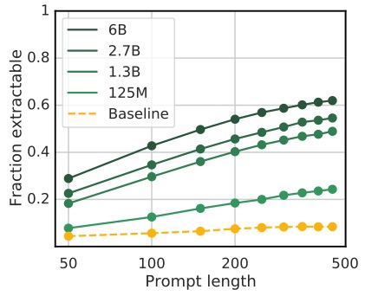
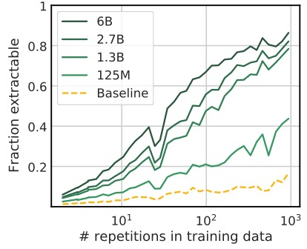
Factors that increase likelihood of memorization
context length in tokens
Nicholas Carlini*, Daphne Ippolito*, Matthew Jagielski*, Katherine Lee*, Florian Tramer*, Chiyuan Zhang*. "Quantifying Memorization Across Neural Language Models." In submission 2022.
Notes:
This baseline is a 1.5B parameter language model that was trained on different dataset from the green lines.
We see that longer contexts and more repetitions DON’T significantly change the amount of the green model’s data we can extract from the orange model.

Slide 119
Our Proposed Deduplication Methods
NearDup: Approximate matching with MinHash
ExactSubstr: Exact matching of document substrings using a suffix array
Notes:
Explanation: Could be that longer documents are more likely to be near-duplicates than shorter documents.

